Slide 1
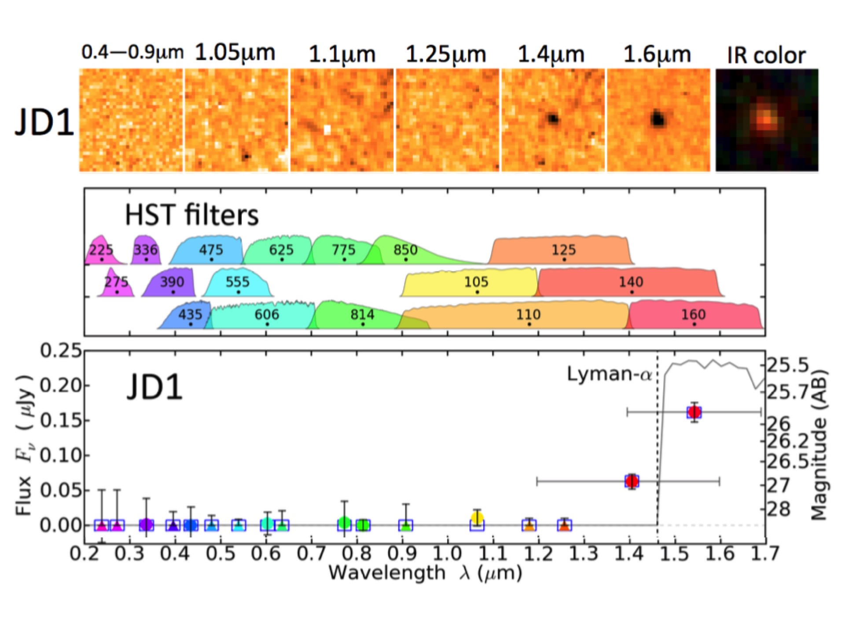

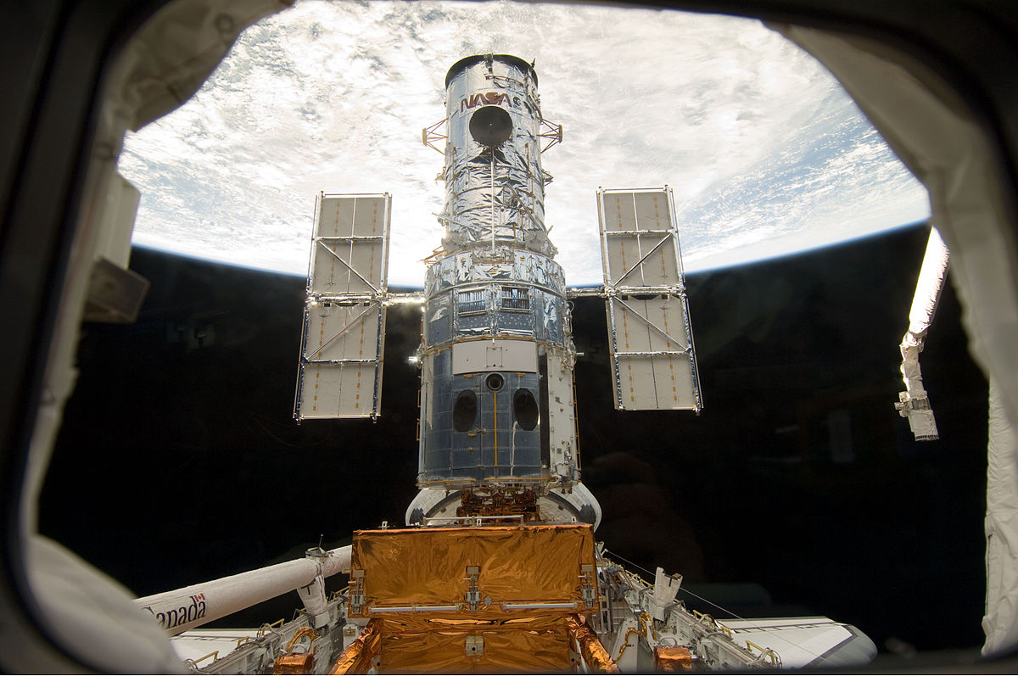
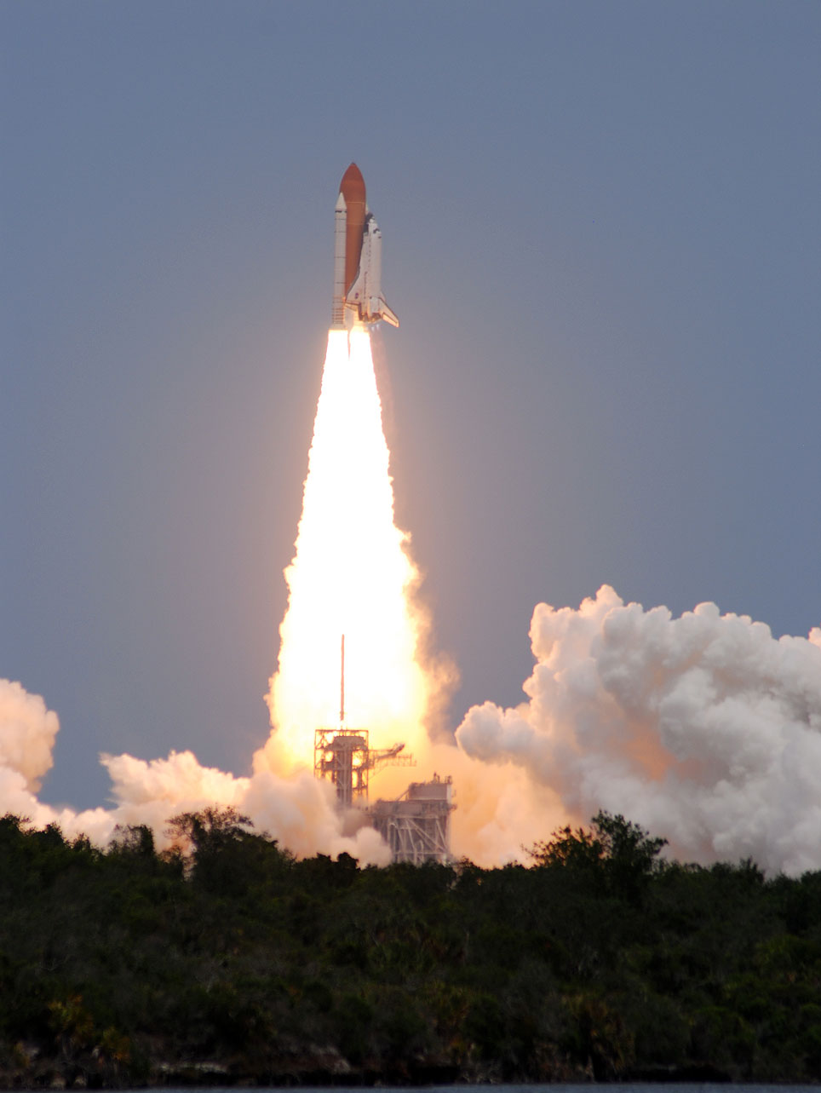
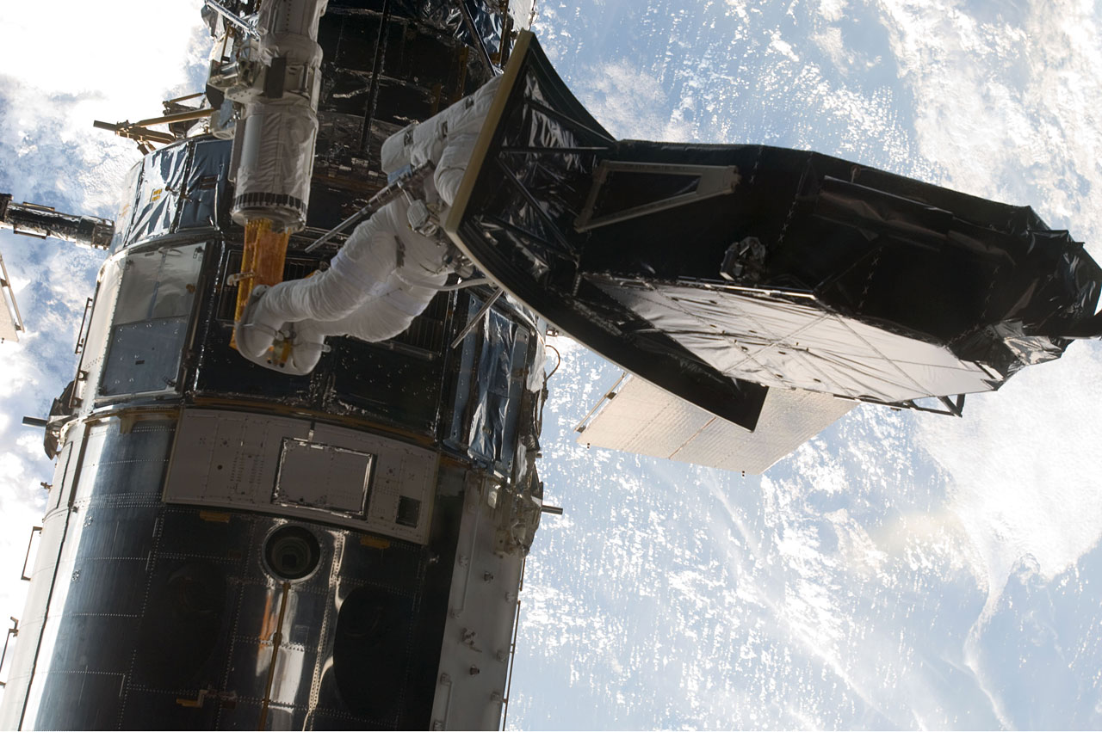
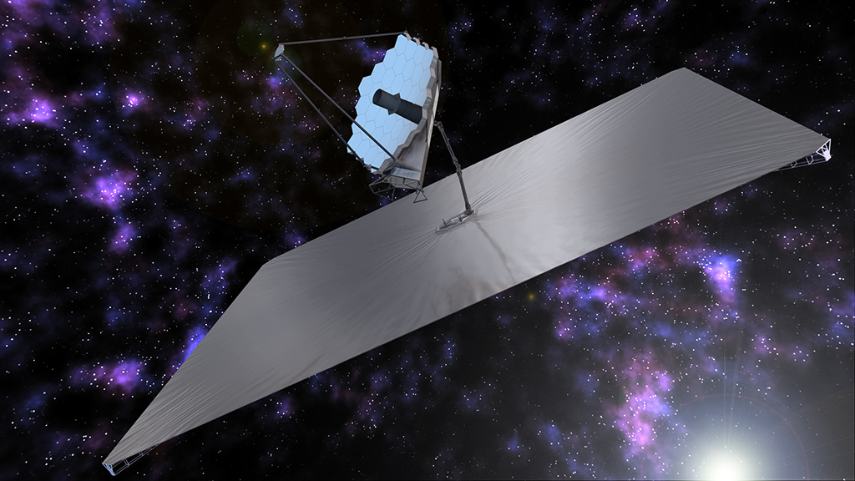
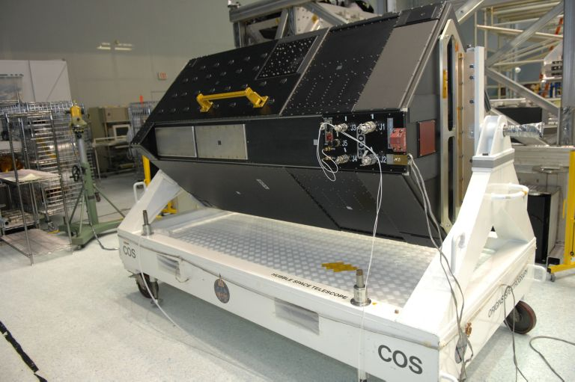
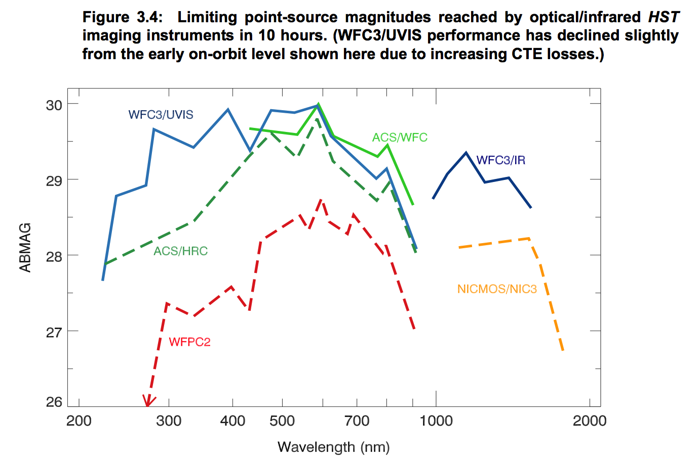
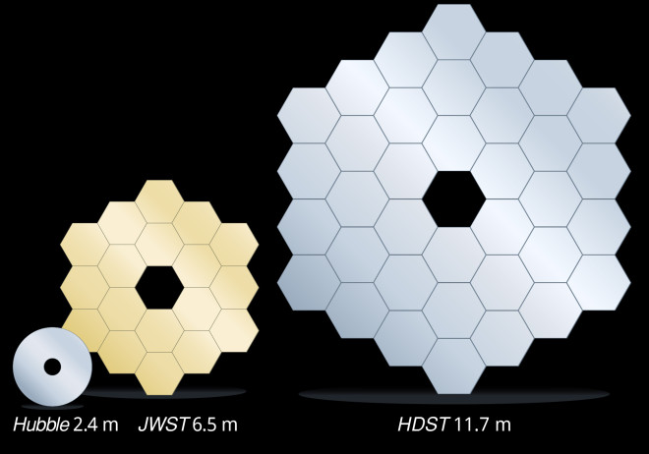
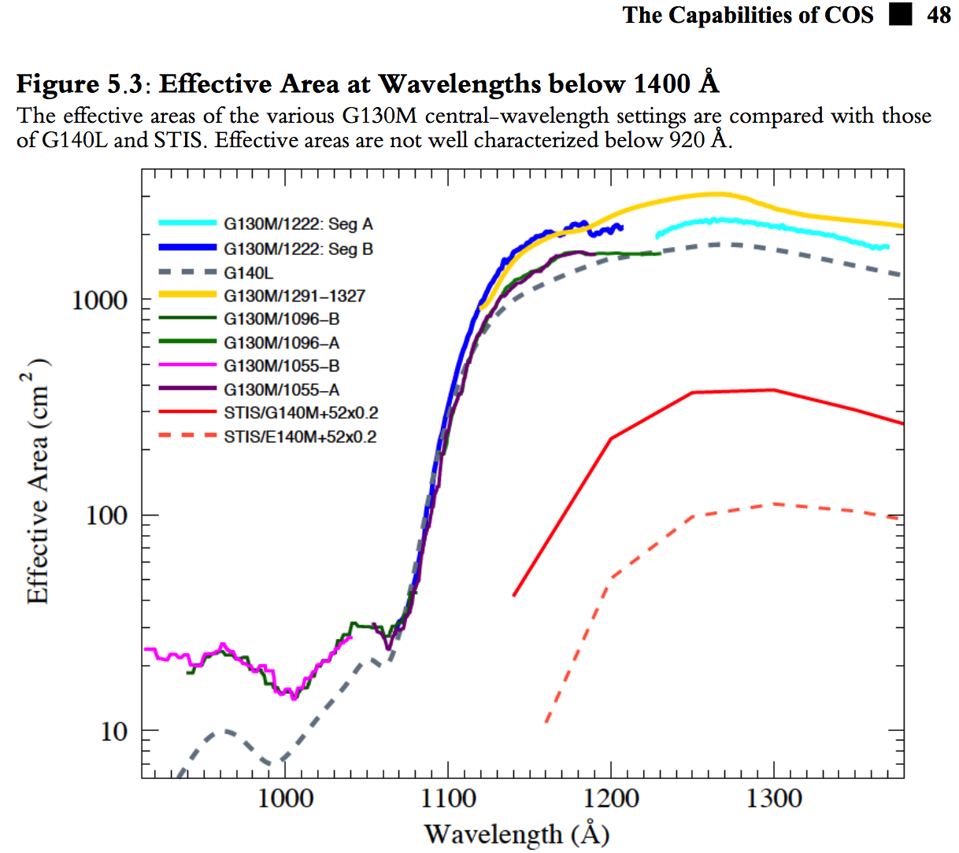
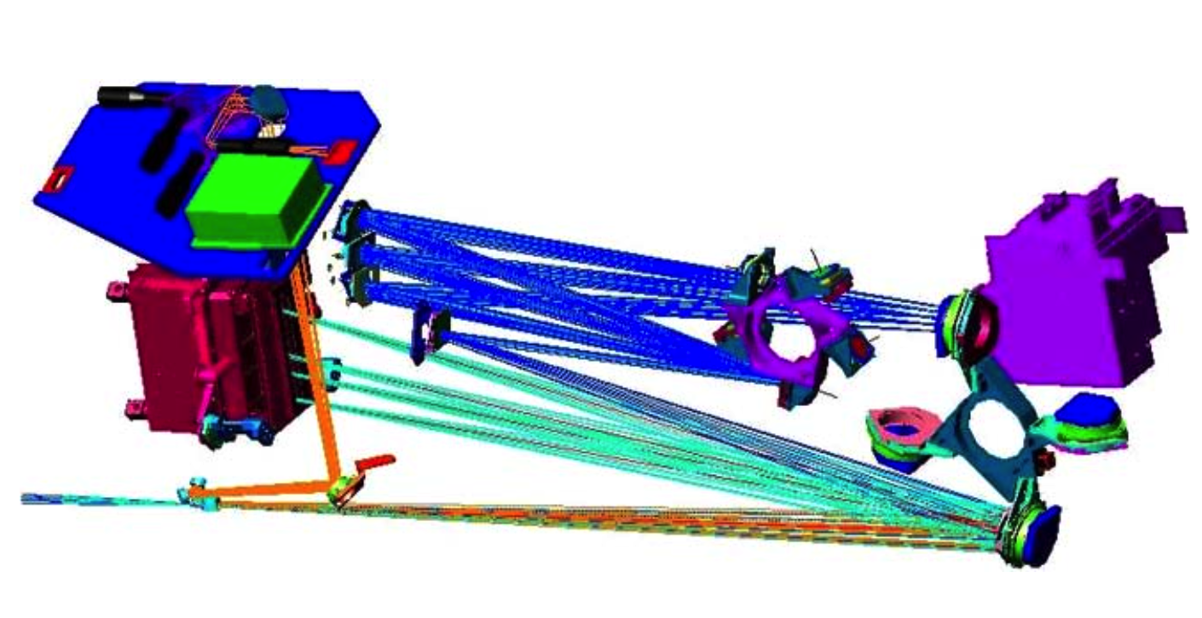
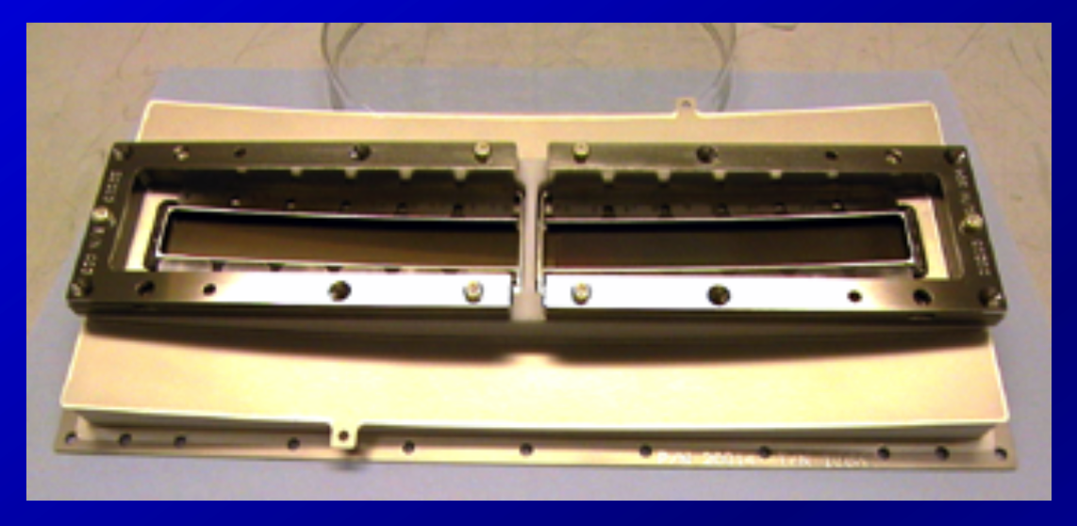
Historical Celebration – 2008 – 2017 – 60 yrs UV Astronomy
2008
2009
2010
2011
2012
2013
2014
2015
2016
2017
HST SM4 (2009)
HST UV Initiative:
making the most of existing assets
Near Future: JWST UV in the IR – The high redshift universe revealed…
COS/CU, Green-PI
WFC3/GSFC, Kimble/McKenty-coPIs
STIS, ACS repaired
Cycle | Proposal | Title | PI | Orb Ext | Orb Para
24 | 14767 | The Panchromatic Comparative Exoplanetary Treasury Program | Sing | 498 | 0
21 | 13346 | Advanced Spectral Library II: Hot Stars | Ayres. | 230 | 0
21 | 1330 | Mapping the AGN Broad Line Region by Reverberation | Peterson | 179 | 0
21 | 13364 | LEGUS: Legacy ExtraGalactic UV Survey | Calzetti | 154 | 154
24 | 14634 | HST-Juno synergistic approach of Jupiter's magnetosphere and ultraviolet auroras | Grodent | 151
22 | 13872 | The GOODS UV Legacy Fields: A Full Census of Faint Star-Forming Galaxies at z~0.5-2 | Oesch | 132 | 132
21 | 13297 | The HST Legacy Survey of Galactic Globular Clusters: Shedding UV Light on Their Populations and Formation | Piotto | 131 | 131
22 | 13650 | The MUSCLES Treasury Survey: Measurements of the Ultraviolet Spectral Characteristics of Low-mass Exoplanetary Systems | France | 125 | 0
24 | 14784 | HAZMAT: Habitable Zones and M dwarf Activity across Time | Shkolnik | 118 | 0
21 | 13398 | A Breakaway from Incremental Science: Full Characterization of the z<1 CGM and Testing Galaxy Evolution Theory | Churchill | 110 | 0
24 | 14610 | A Legacy Imaging Survey of M33. | Dalcanton | 108 | 0
24 | 14675 | Metal Evolution and TrAnsport in the Large Magellanic Cloud (METAL): Probing Dust Evolution in Star Forming Galaxies | Roman-Duva | 101 | 0
23 | 14071 | How are HI Disks Fed? Probing Condensation at the Disk-Halo Interface | Borthakur | 100 | 0
22 | 13846 | The COS Absorption Survey of Baryon Harbors (CASBaH): Probing the Circumgalactic Media of Galaxies from z = 0 to z = 1.5 | Tripp | 99 | 0
23 | 14268 | Project AMIGA: Mapping the Circumgalactic Medium of Andromeda | Lehne | 93 | 0
Far Future: LUVOIR/HabEx:
Same Science Different Price Points
Astrophysics “Suborbital Portfolio”:
Building the Future Now
STS-125
WFC3
New Science, New Technology, New Workforce
PI | Program SR = Sounding Rock BA = Balloon | Band | Science | Technologies | Future Mission Relevance | GS/PostDocs
Bock | SR:CIBER-2 | IR | Cosmic IR Background | Wide Field Ramp Filter spectrograph | Explorer/Probe | Lanz, Zemcov, Sullivan
Chakrabarti/Cook | BA:PictureC | Vis | Planetary Environment of Epsilon Eridani | Vector Vortex Coronagraph: Deform mirrors; high precis pointing system; light weight SiC mirrors; MKID | WFIRST/HabEx/LUVOIR | Douglas, Mendillo
Figueroa | SR:Micro-X | Xray | Puppis SNR resolved Xray velocity structure | X-ray Micro-calorimeter: Adiabatic Demagnetization Refrigerator | Hitomi | Goldfinger
France | SR:CHESS | Far-UV | High Resolution Spectroscopy of ISM surrounding the Brightest Stars | High Resolution Echelle Spectrograph: high efficiency blazed gratings with low intrinsic scatter | HabEx/LUVOIR | Hoadley, Fleming
Galeazzi | SR:DXL | Xray | Sources of Diffuse X-ray Background | Large area gas-proportional counters multiple soft x-ray bands | Explorer | Thomas, Liu
Green | SR:DEUCE | EUV | B-star Lyman Continuum Emission | Large Area Borosilicate MCP with X-strip anode | HabEx/LUVOIR | Schindhelm, Nell, France
Kaiser | SR:ACCESS | Vis/IR | Precision Stellar Calibration (1%) | High Precession Calibration: High Uniformity MgF₂/Al mirrors; High stability LEDs | Euclid/WFIRST/HabEx/LUVOIR | Morris
Martin | BA:Fireball-2 | Near-UV | Lyman Alpha Cosmic Web | Near-UV Multiobject Spectrograph;UV fibers; delta-doped EMCCDs | Explorer/ProbeHabEx/LUVOIR | Jewell, Hamden, Morrissey
McCandliss | SR:NextGenFORTIS | Far-UV | Utility of Wide-field Far-UV MultiObject spectroscopy: Blue stragglers on GC; Low Met. SF in Mag Brid.; Shocks in SNR; Lyα escape | Far-UV Multiobject Spectrograph-NextGen Microshutter Array-Large Aspheric Gratings-Large Area MCP | Expl/Probe/HabEx/LUVOIR | Sahnow, Morrissey, McPhate, Burgh, France, Lupu, Fleming, Redwine
McEntaffer | SR:WRX-R/OGRE/ | Xray | WRX-R:Vela SNR Soft Xray diagnostics of SNR/ISM interaction OGRE: Soft Xray obs of Capella | WRX-R: Water Recovery; Soft Xray Det OGRE: High efficiency Off-plane grating spectrometer | Athena | Miles, Tutt
COS

