Slide 1
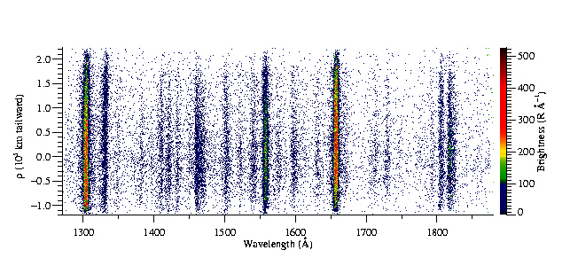
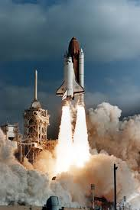
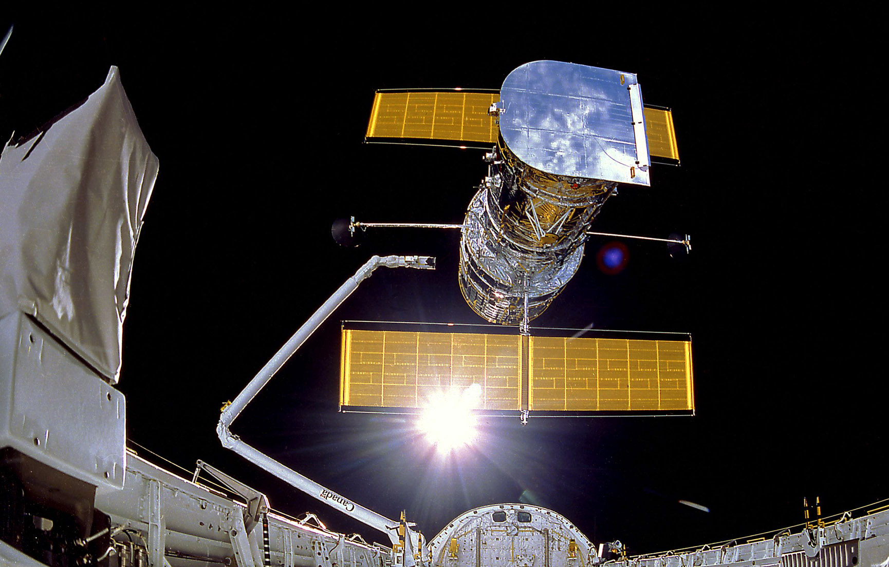
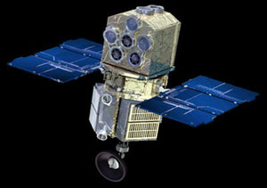
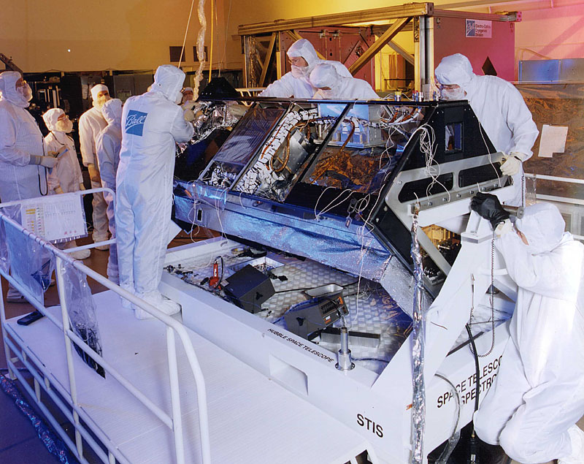
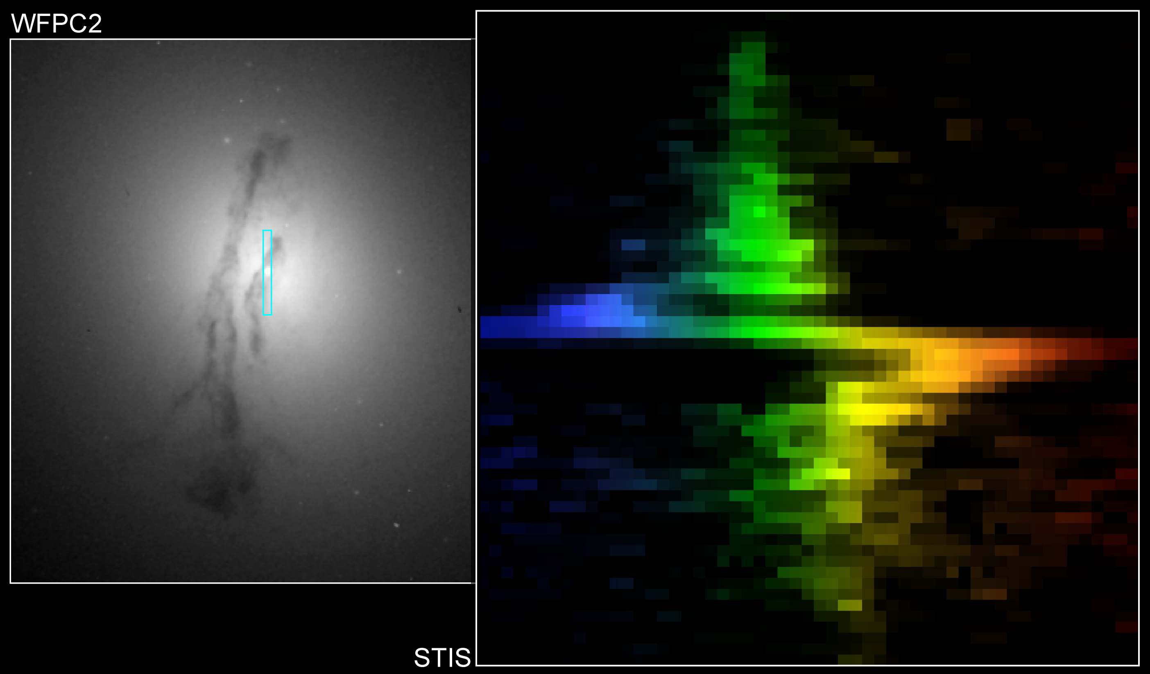
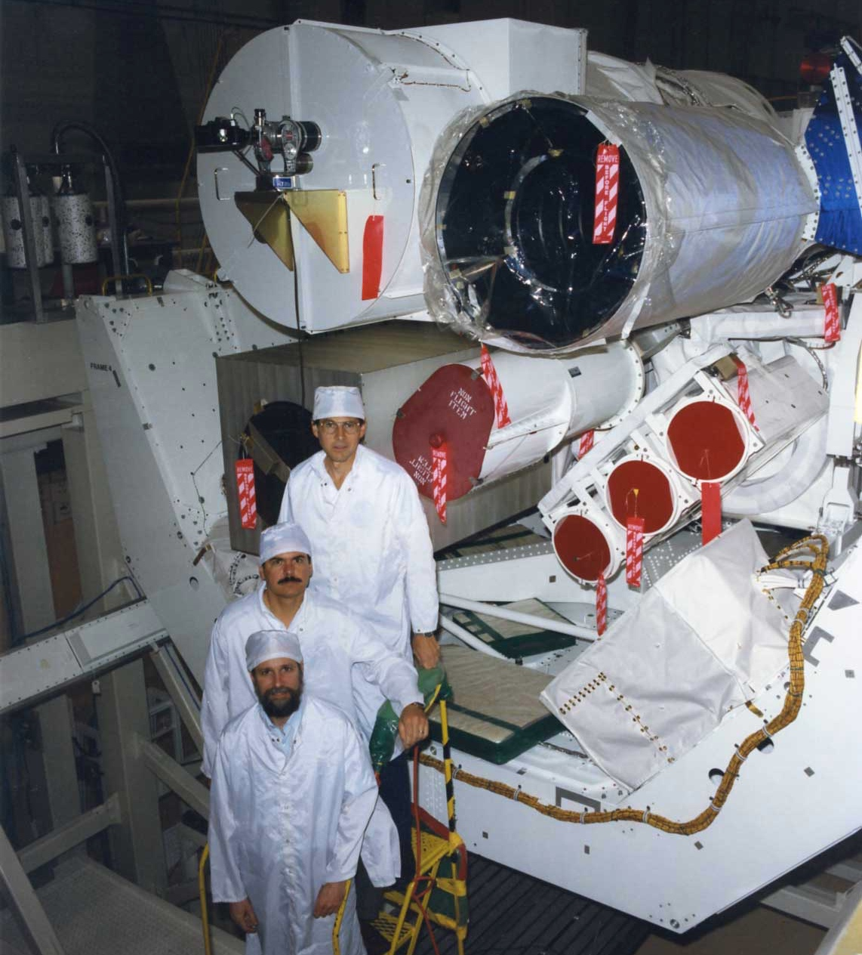
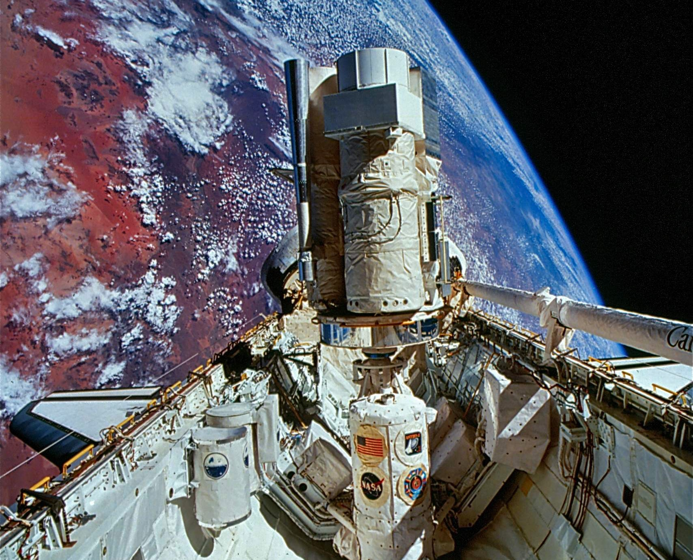
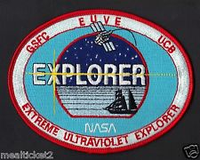
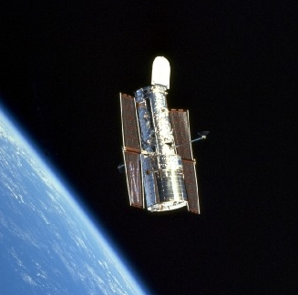
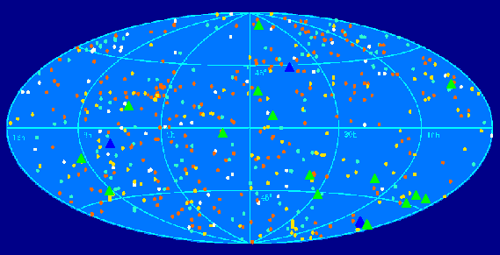

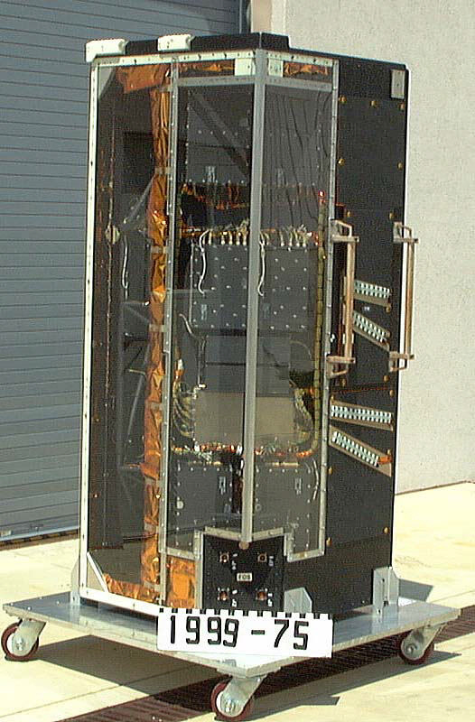
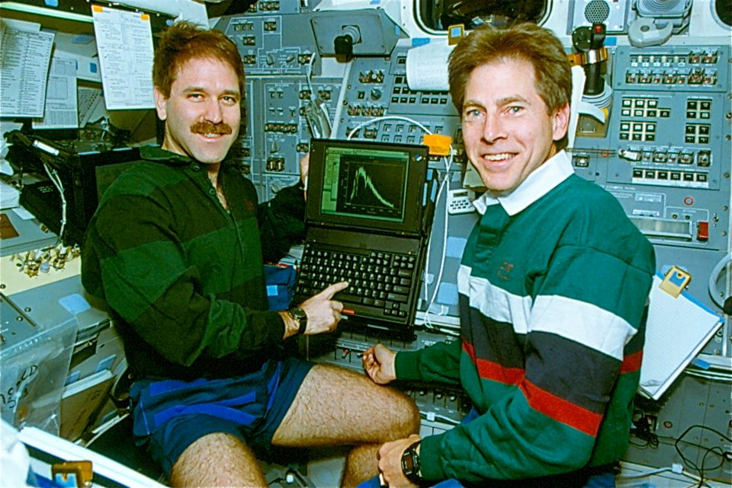
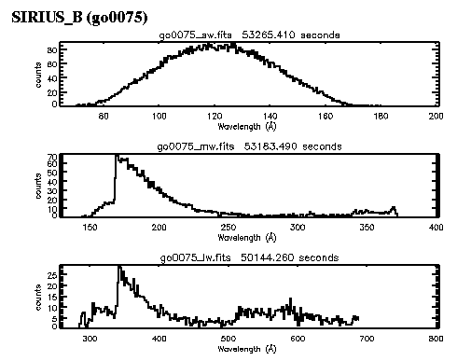
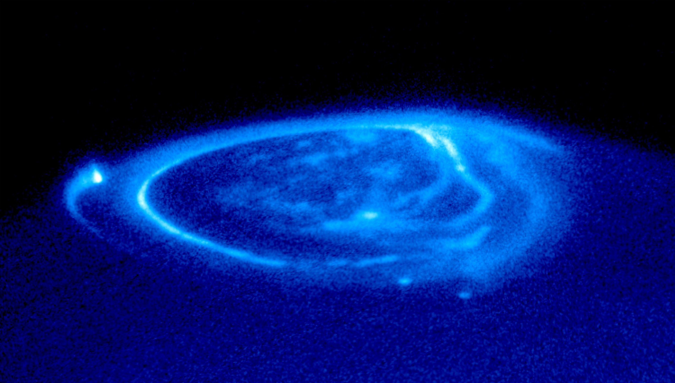
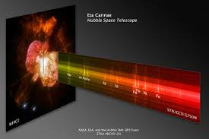
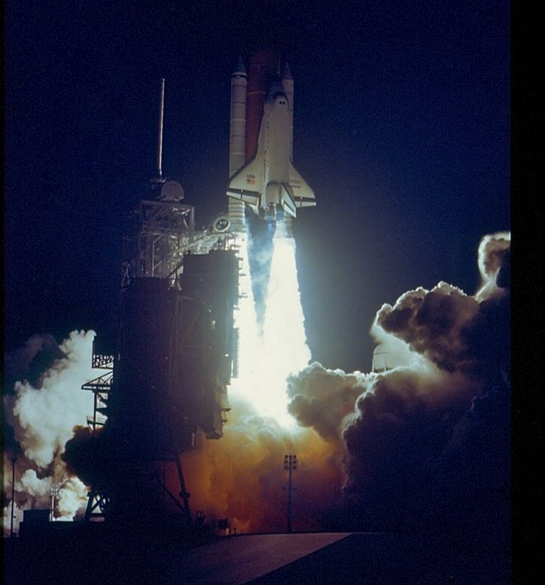
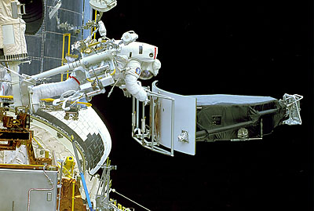
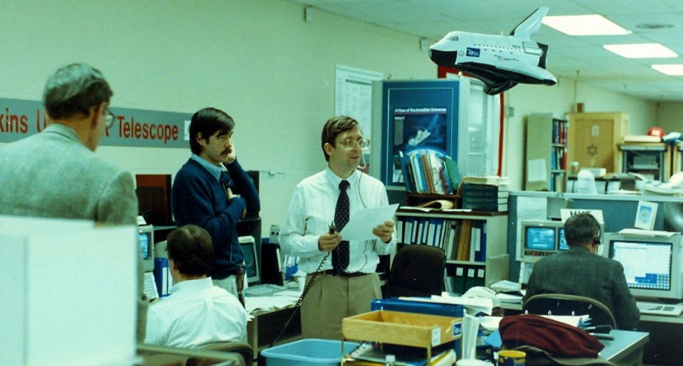
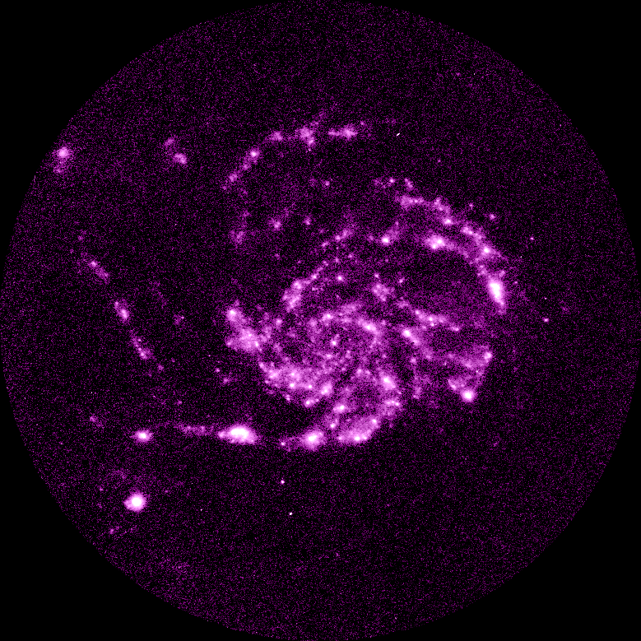
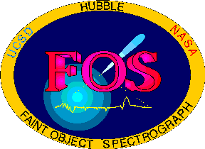
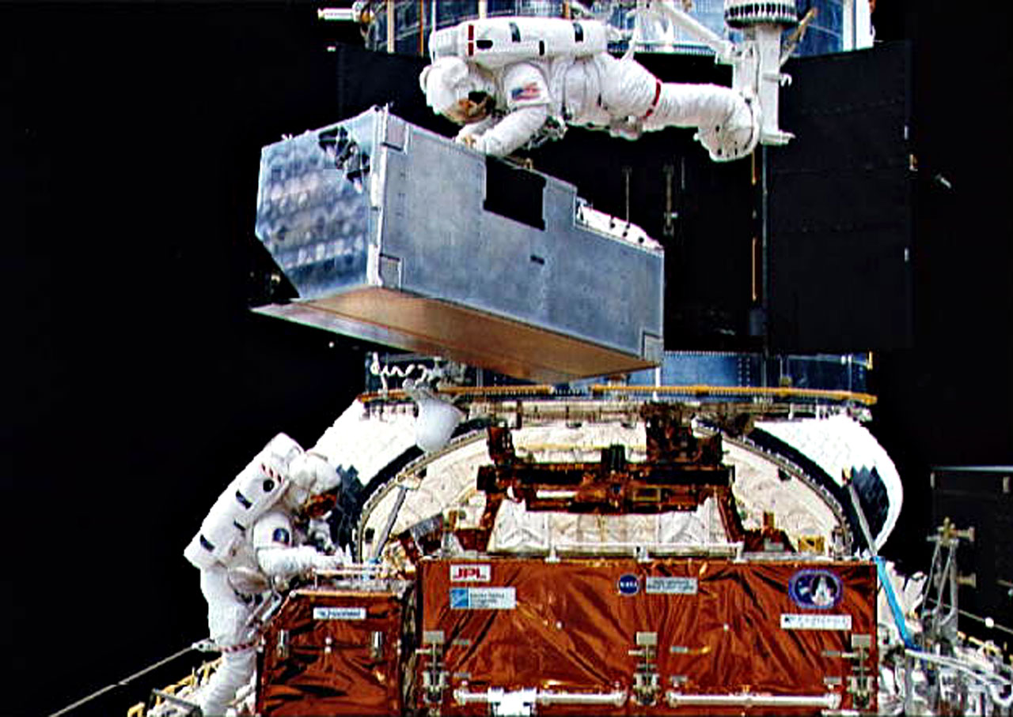
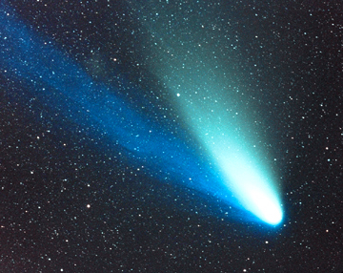
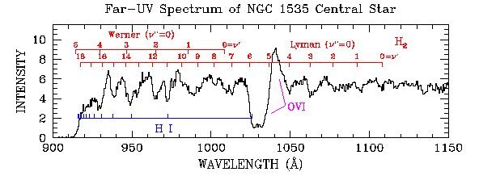
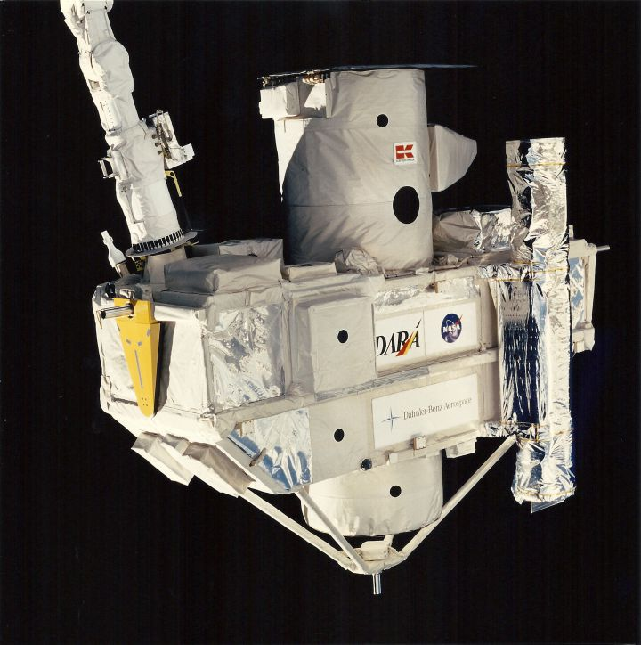
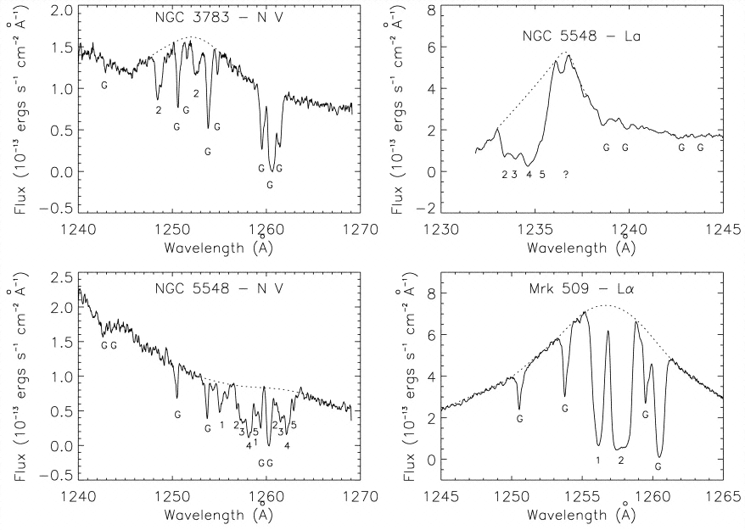
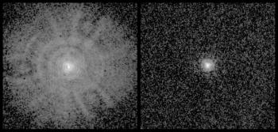
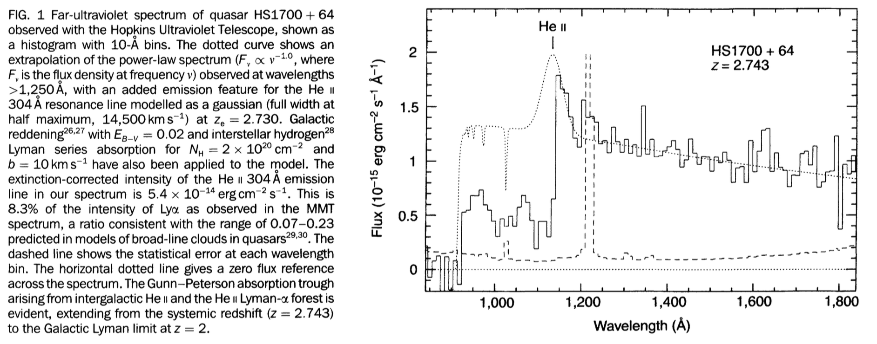
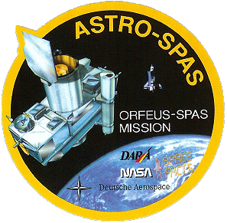
Historical Celebration – 1988 – 1997 – 60 yrs UV Astronomy
1988
1989
1990
1991
1992
1993
1994
1995
1996
1997
O
C+
S
C
C
S
HST Launch (Apr. 1990)
& SM1 (Dec. 1993)
Astro-1 STS-35 (1990) &
Astro-2 STS-67 (1995)
EUVE (1992)
Bowyer -PI
STIS/HST
(SM2,1997)
STS-31,
Apr. 24, 1990
  HUT (JHU, Davidsen-PI)
  UIT (NASA/GSFC, Stecher-PI)
  WUPPE (U. Wisc., Code-PI)
FOS
WFPC2
Comet Hale-Bopp NASA/JHU Sounding Rocket 36.156UG
(April 1997) Feldman-PI
MSFC POCC
ORFEUS
STS-51 (1993)
STS-80 (1996)
STS-67 launch
HUT spectra
BEF (UCB, Hurwitz-PI)
IMAPS (Princeton, Jenkins – PI)
COSTAR
UIT-M101
Strongest Ever Carbon Monoxide Emission
GHRS spectra

