Slide 1
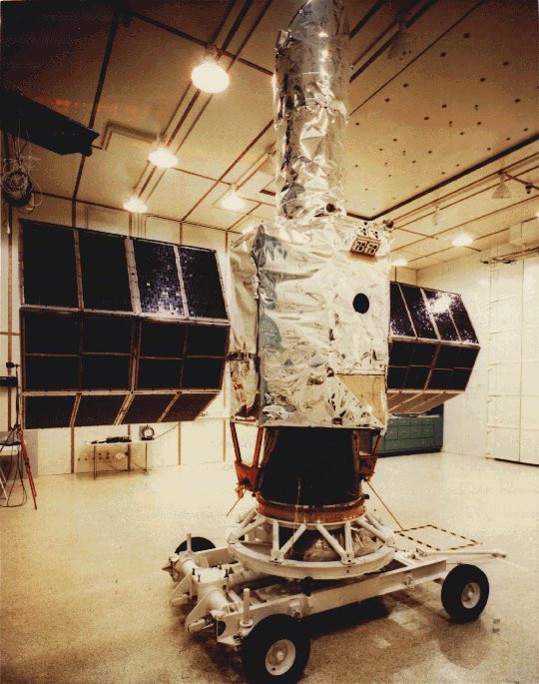
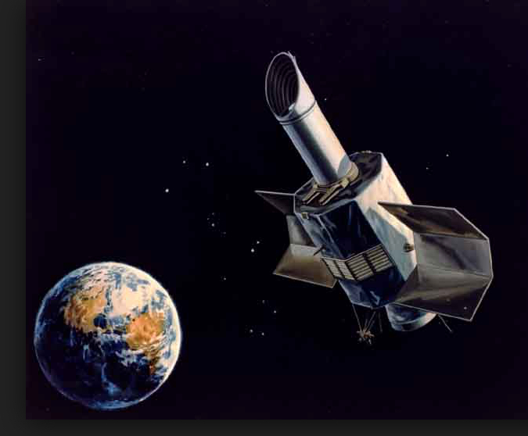
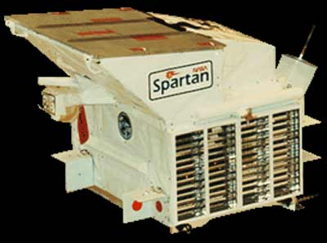
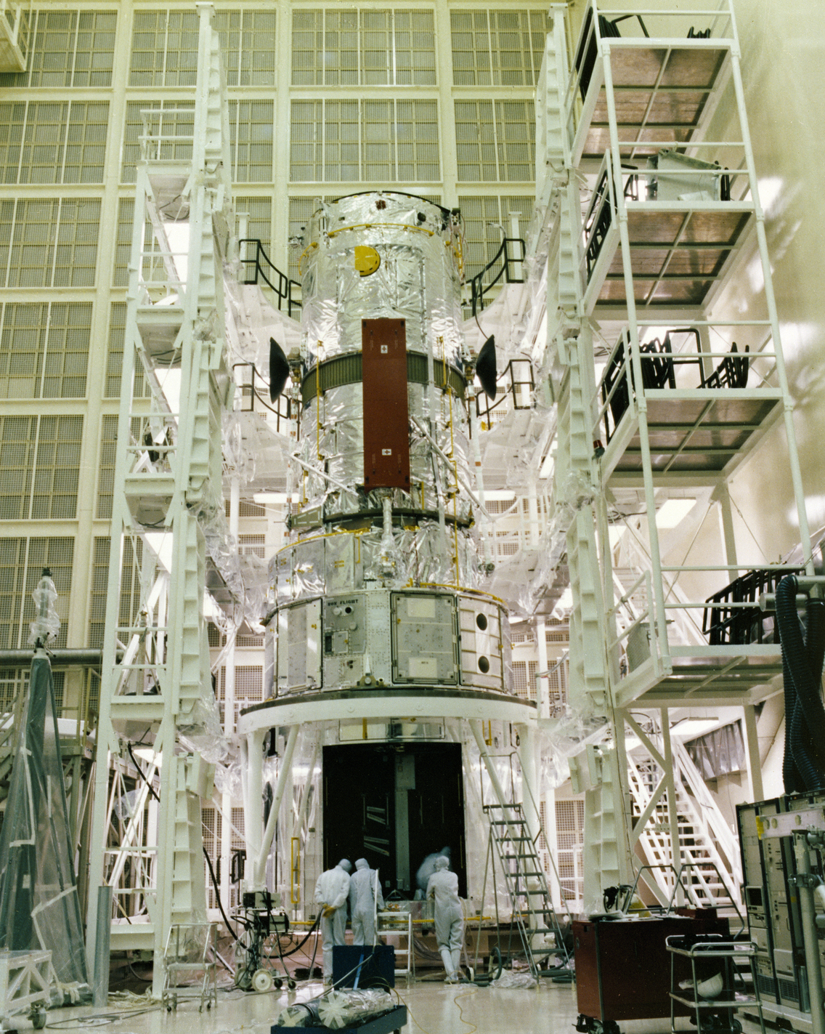
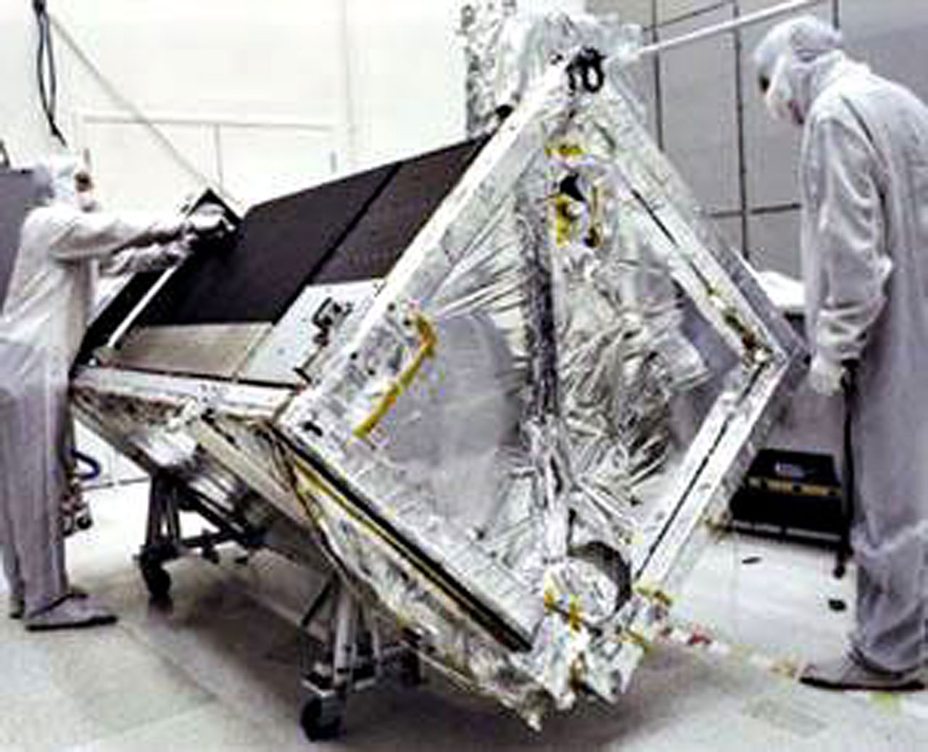
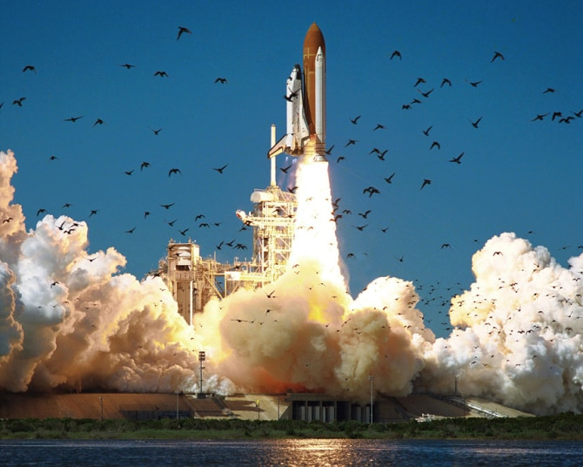
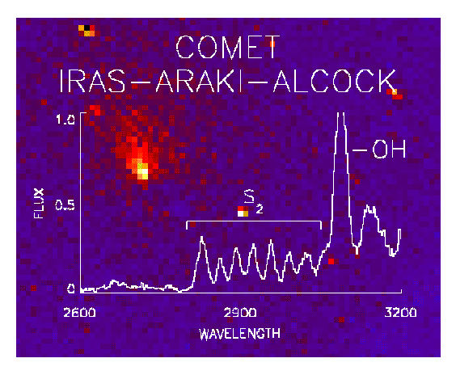
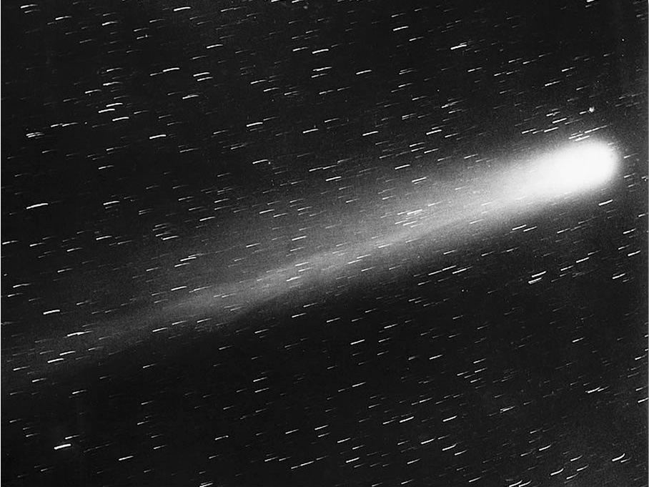
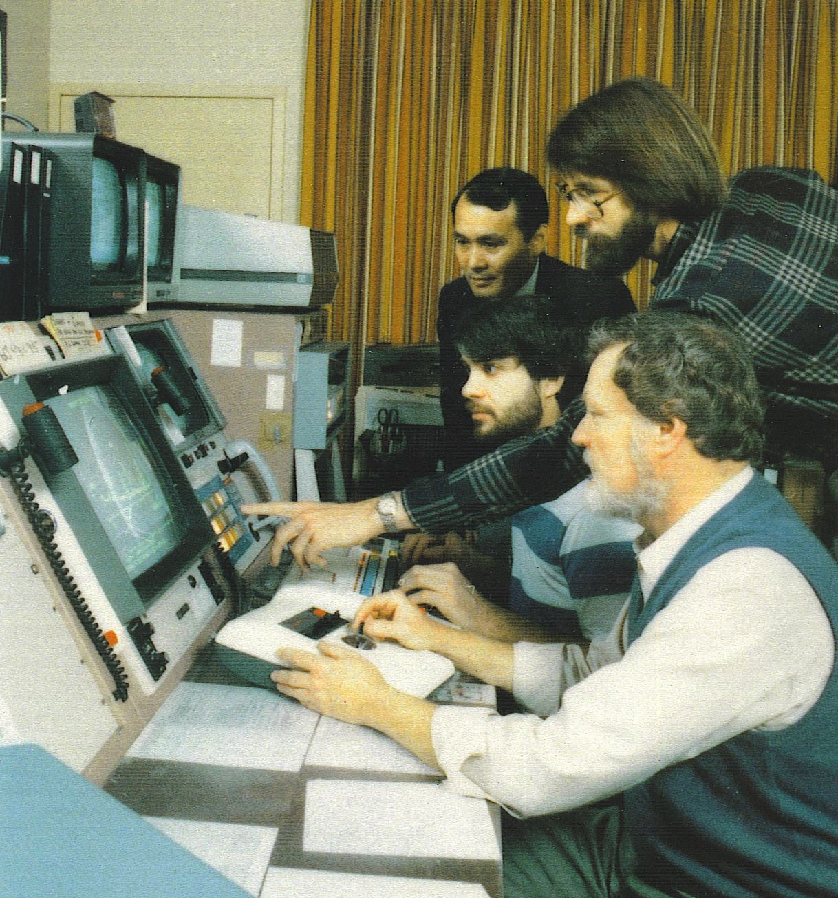
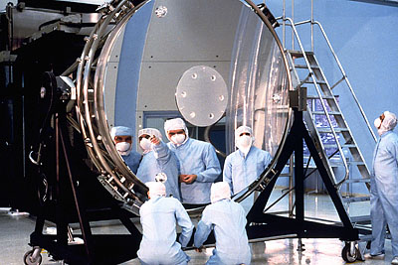
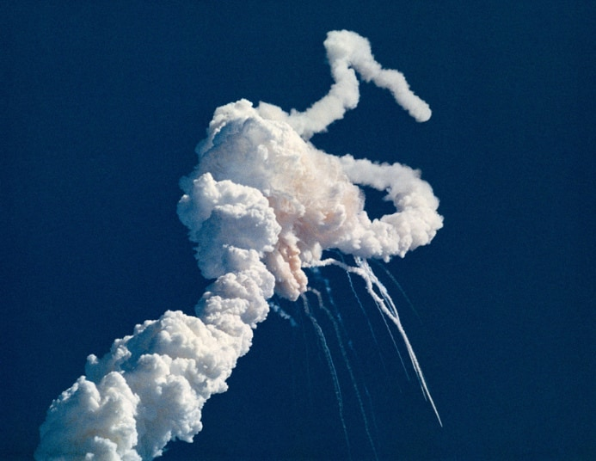
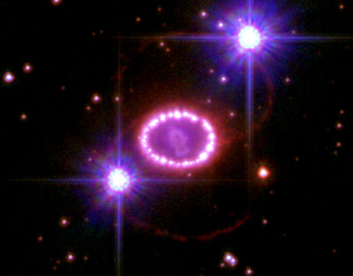
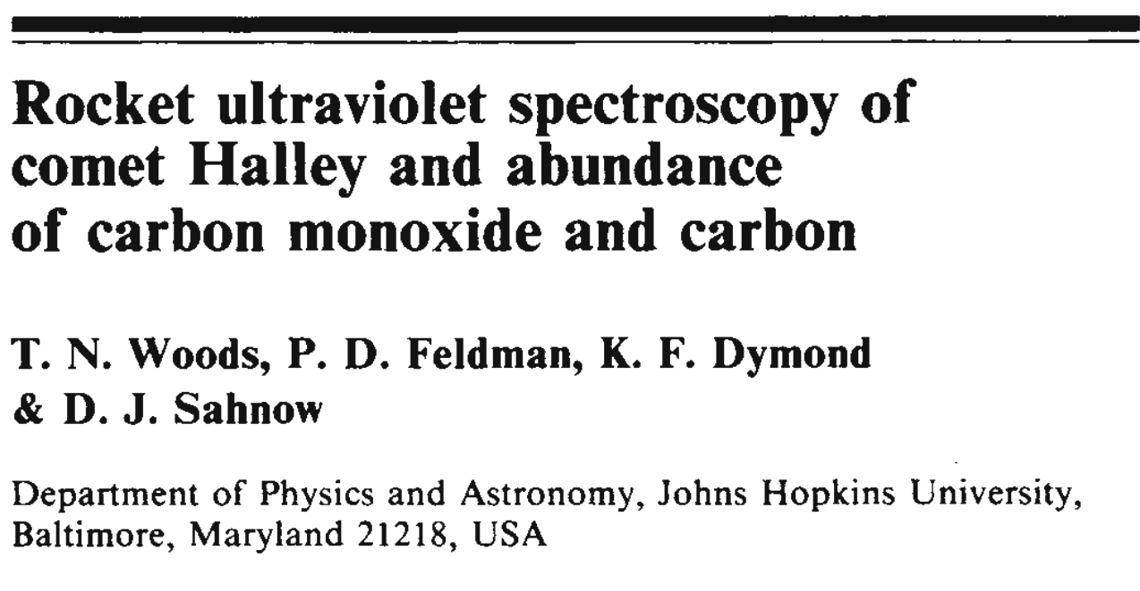
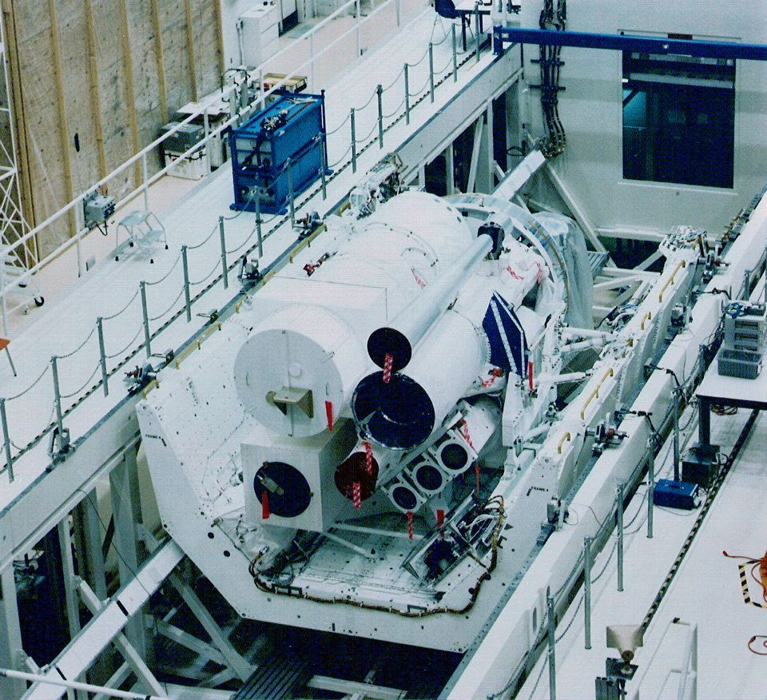
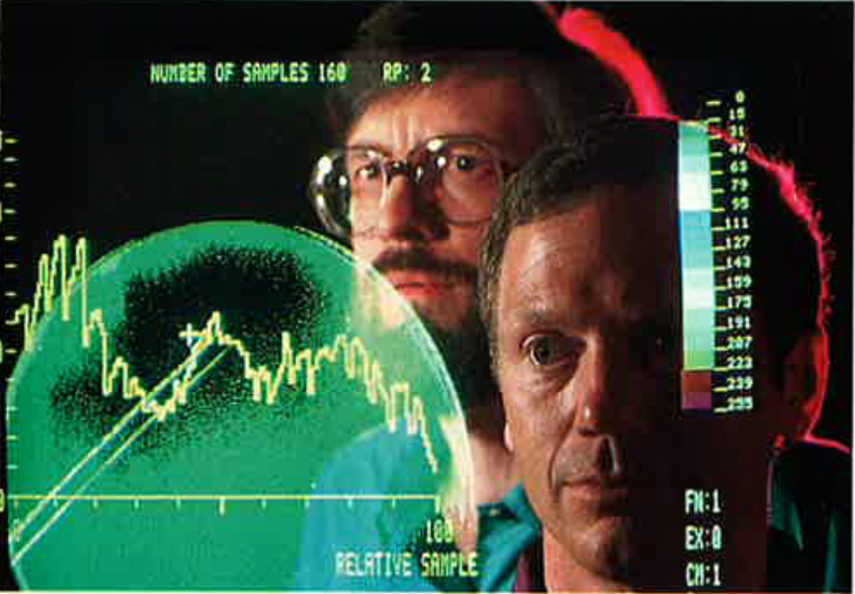
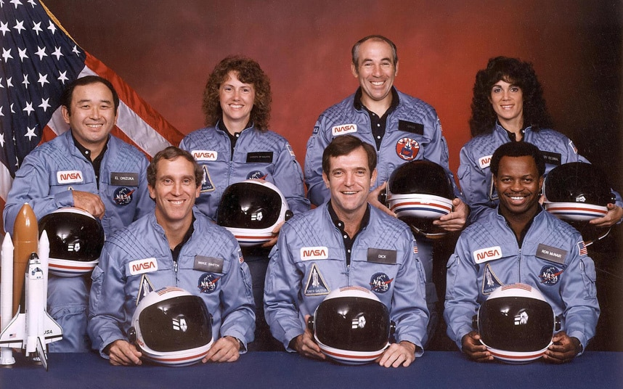
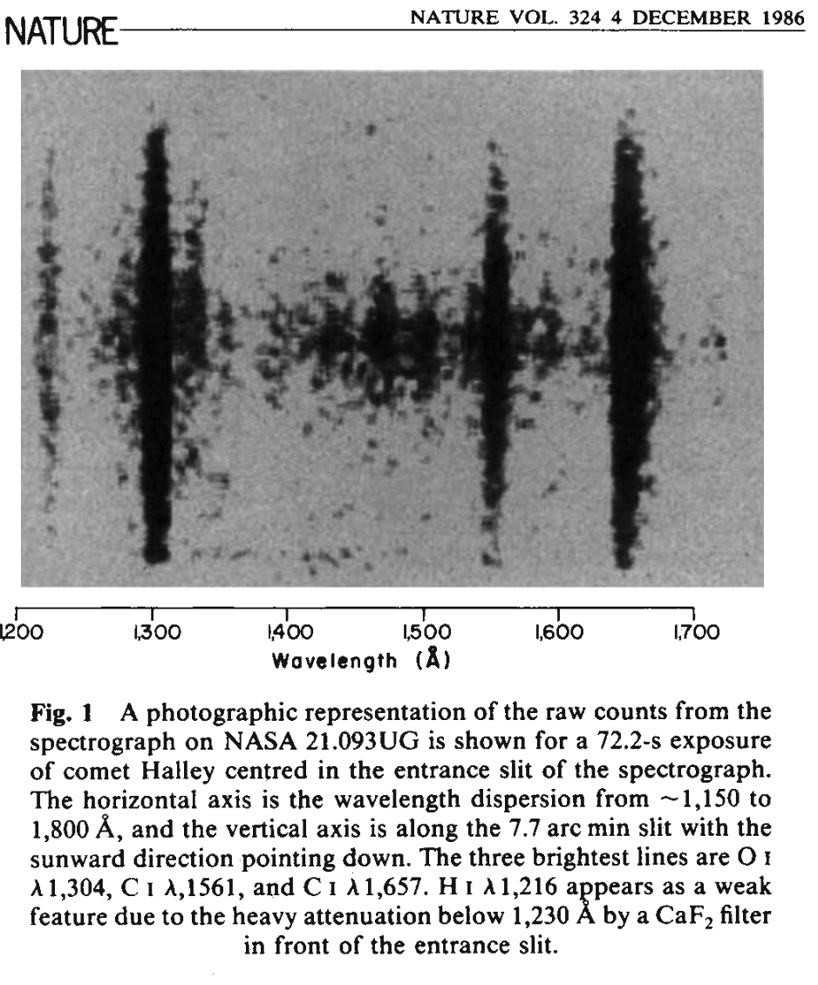
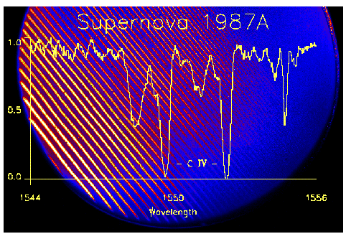
Historical Celebration – 1978 – 1987 – 60 yrs UV Astronomy
1978
1979
1980
1981
1982
1983
1984
1985
1986
1987
IUE (1978 - 1996)
Challenger
(Jan. 28 1986):
(Hubble and Astro Observatory space shuttle launches delayed from early 1986 to 1990.)
Spartan-203 (Halley)
on Challenger
was lost
Est. at JHU Homewood, 1982
HST at Lockheed
IUE Control Center, NASA/GSFC
Hubble (above and left) and Astro Observatory (below) developed, tested, and prepared for launch in 1986. But…
JHU Halley Sounding Rocket Mission Mounted one month later 26 Feb 1986 (21.093UG) and again on 13 March 21.095UG) , supporting Giotto flyby
SN 1987a
The crew of Challenger,
STS-51-L
HUT, UIT, and WUPPE

