Slide 1
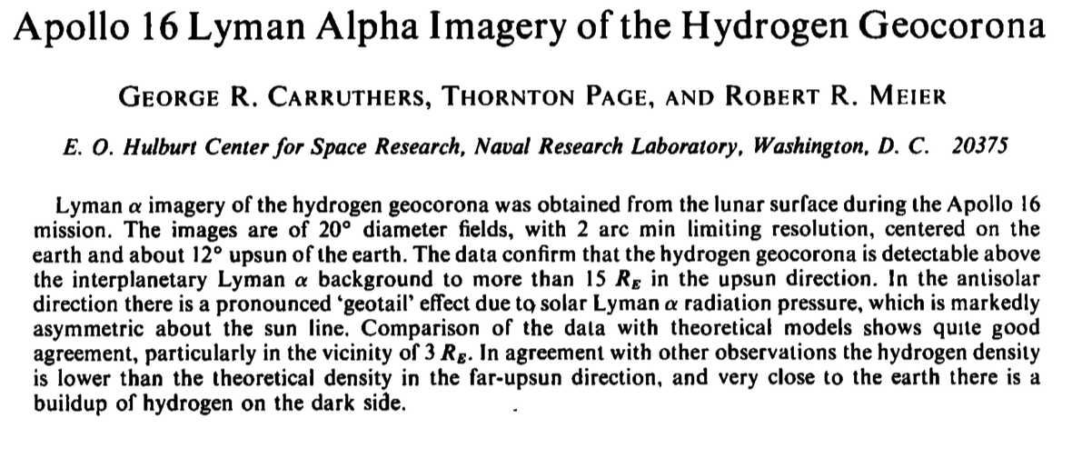
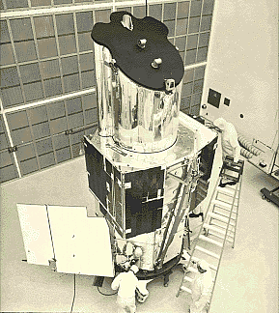
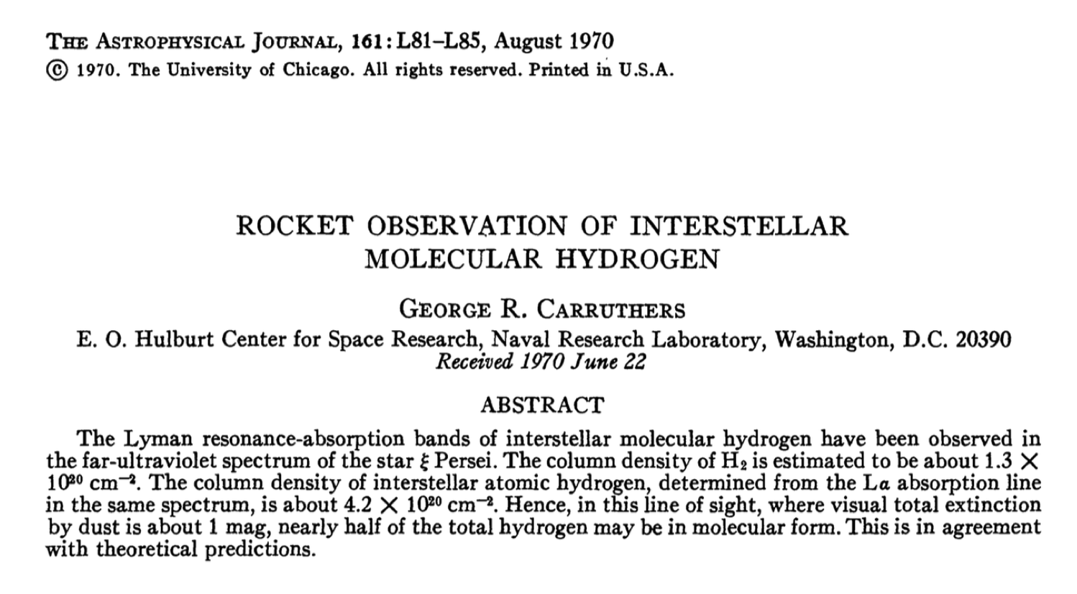
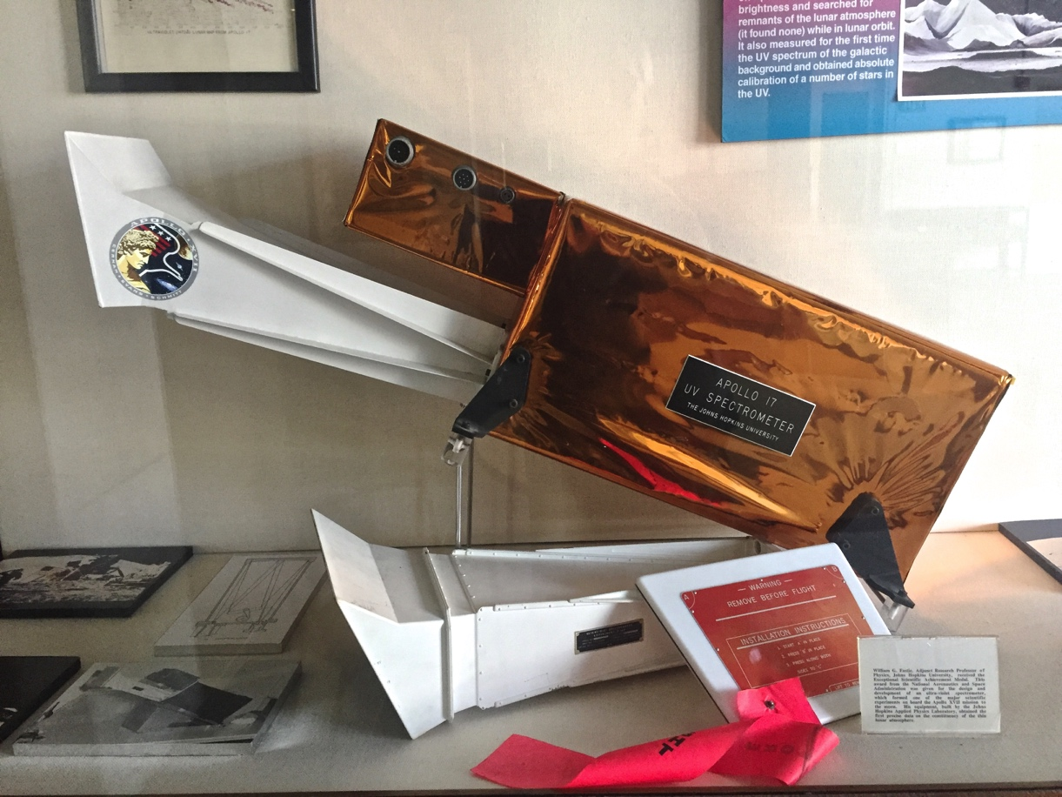
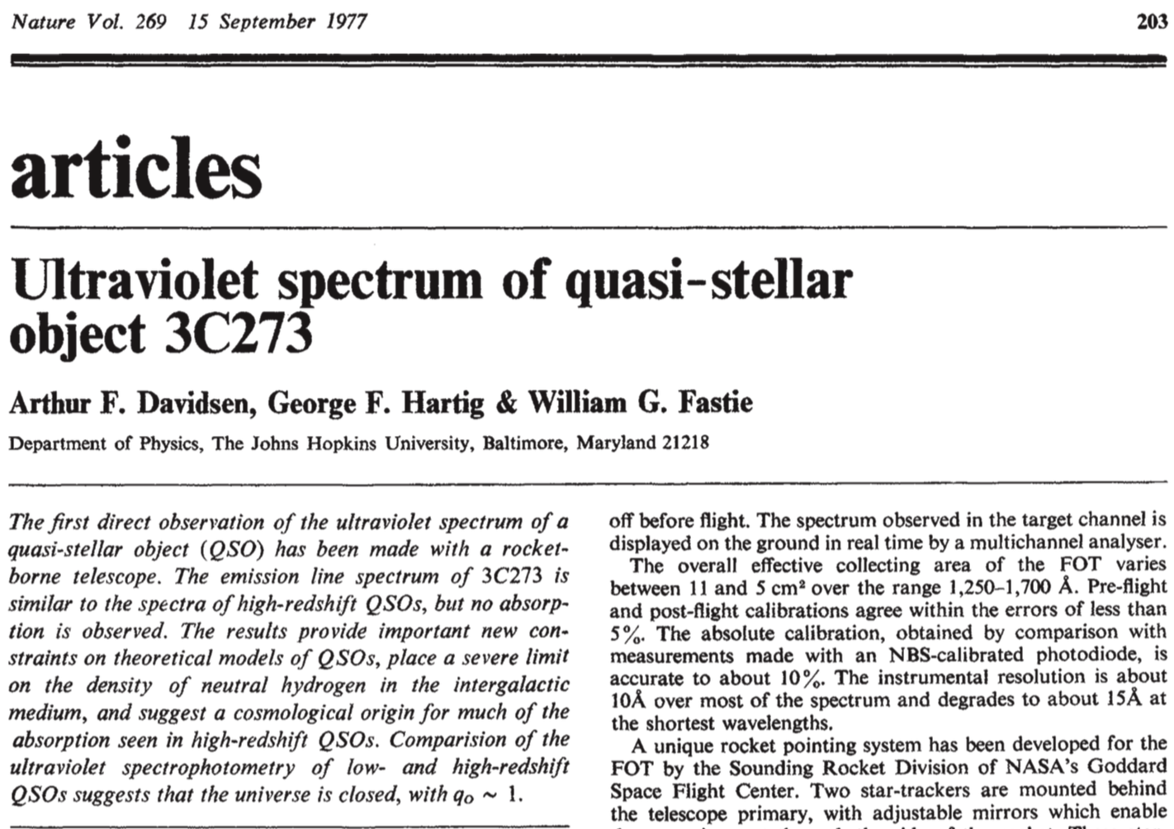
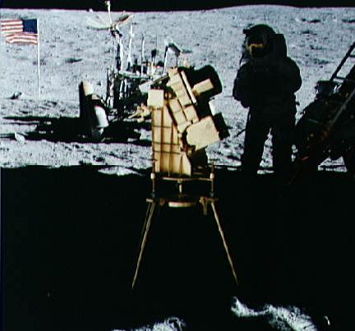
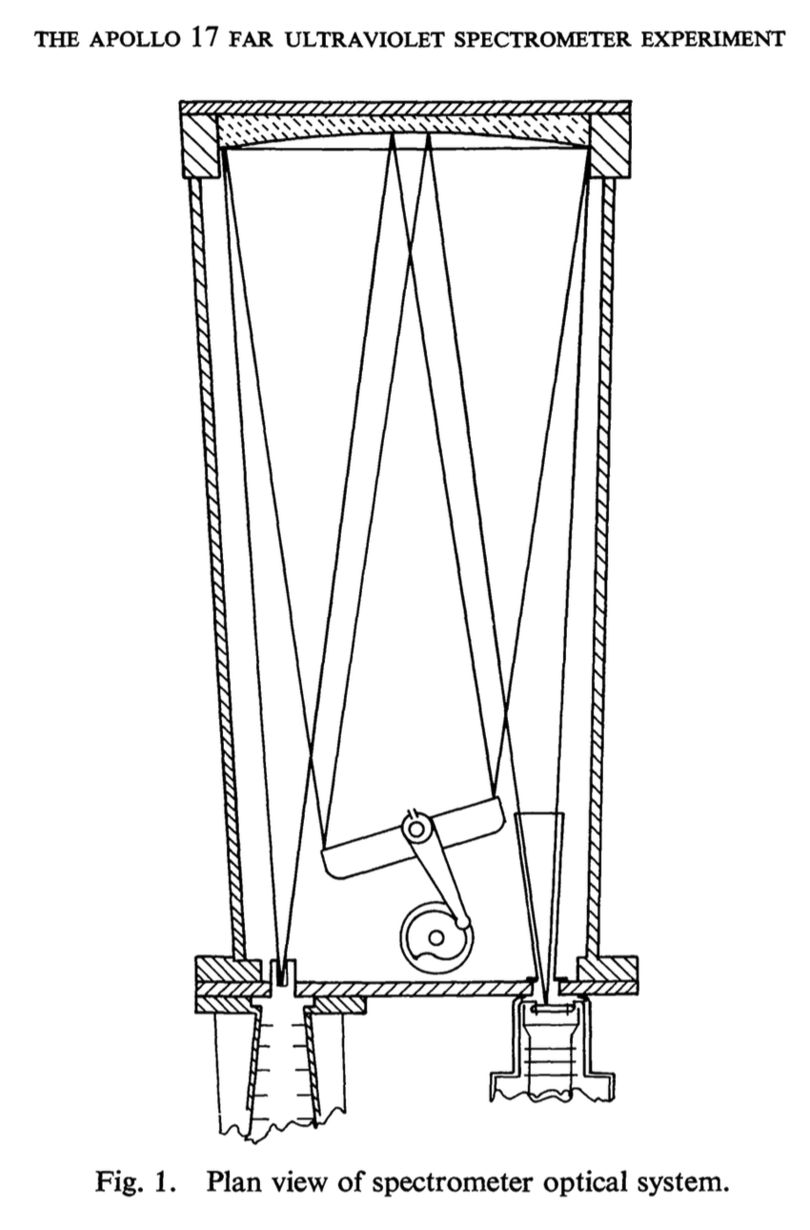
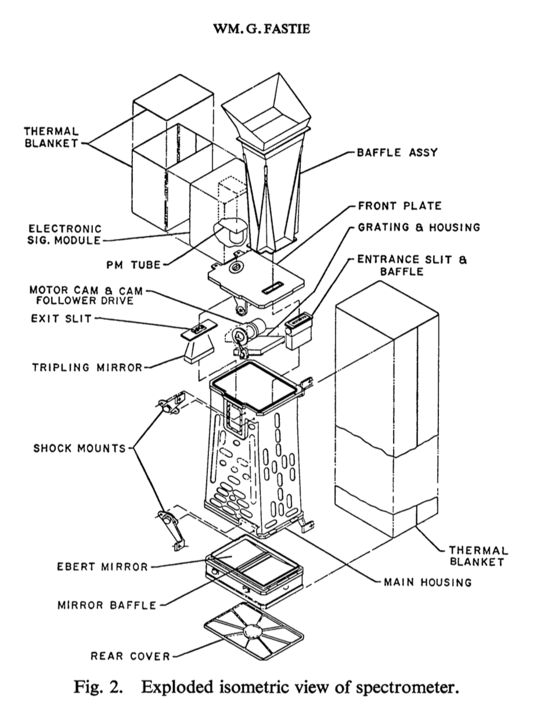
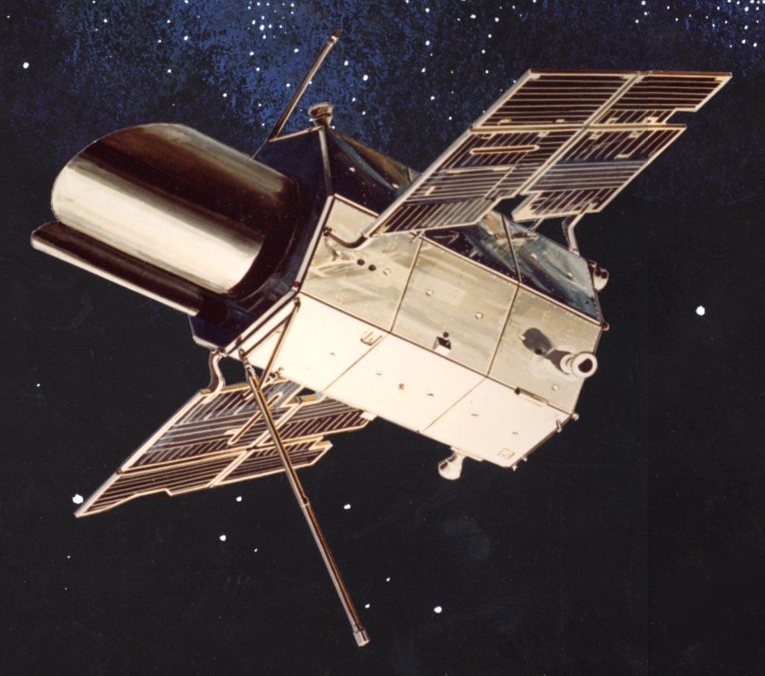
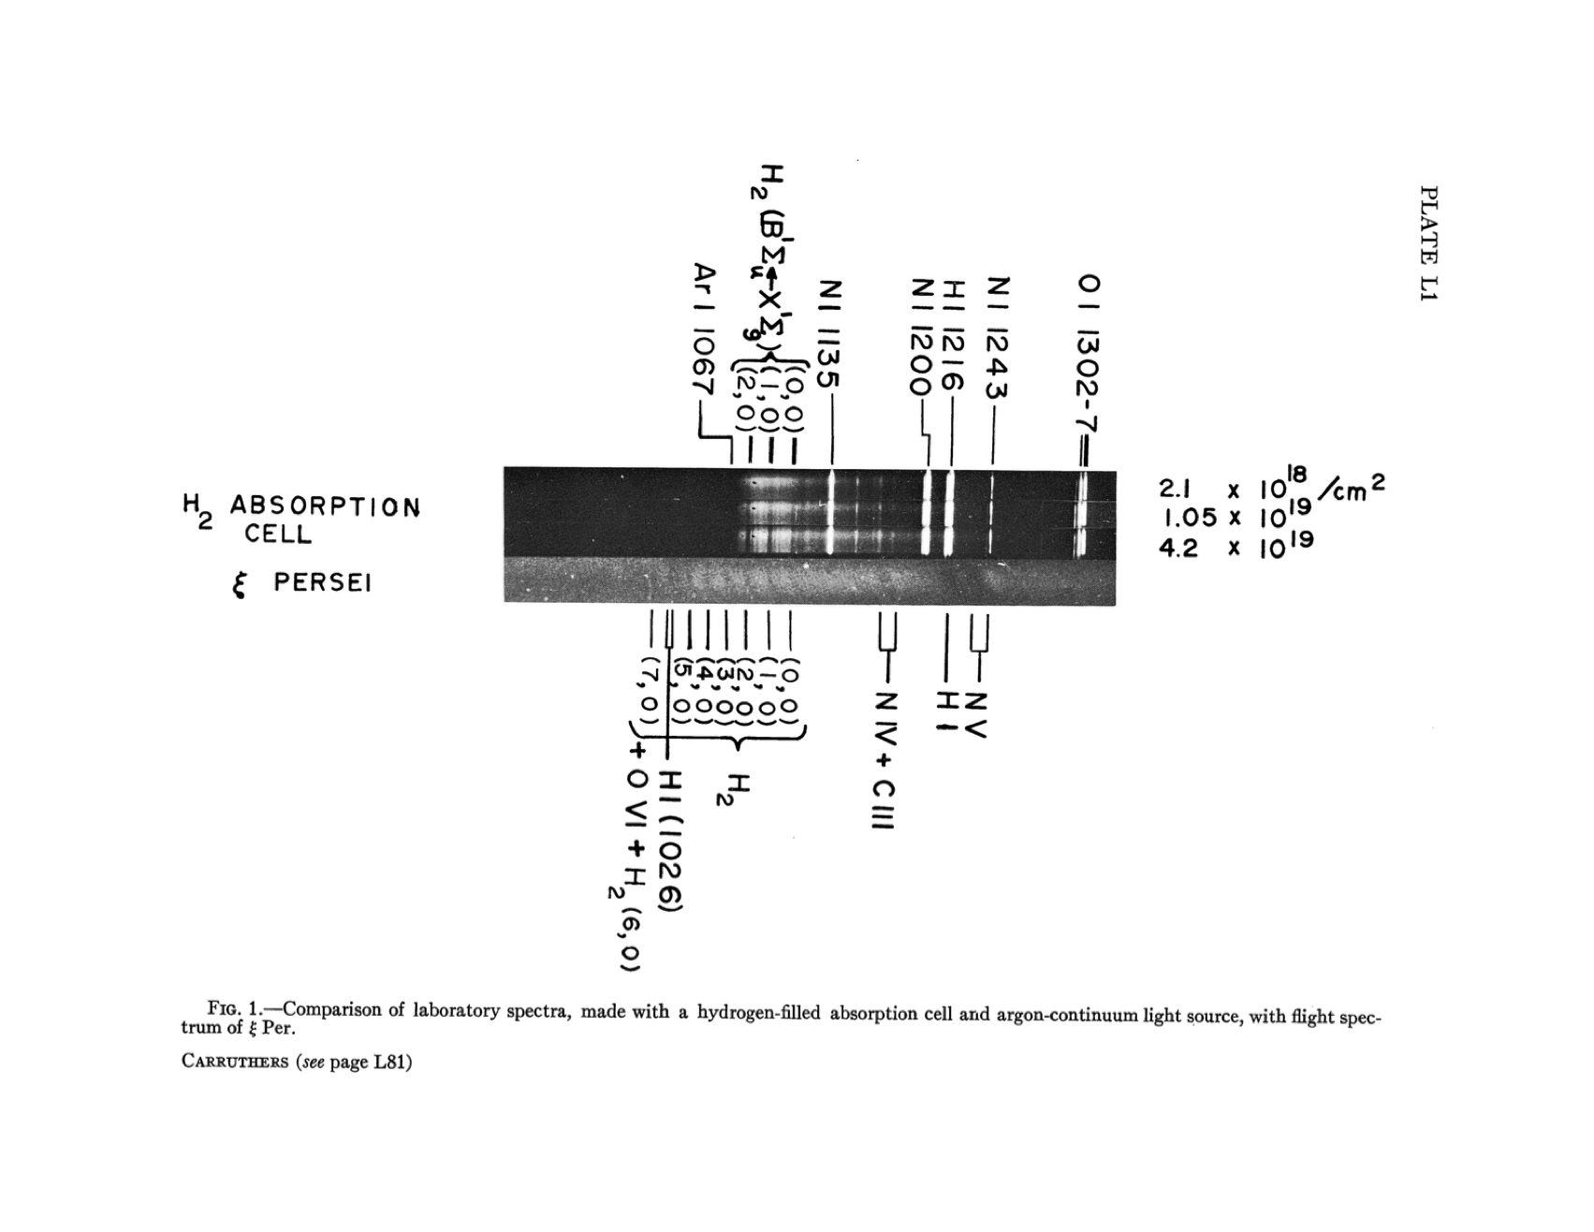
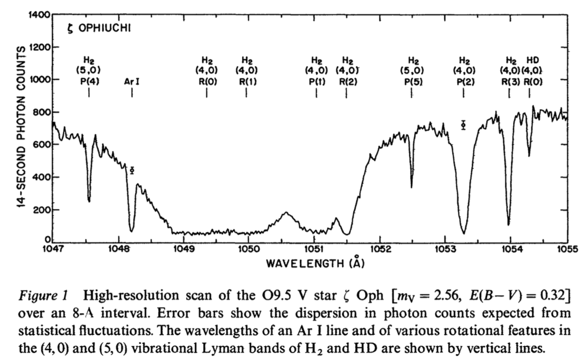
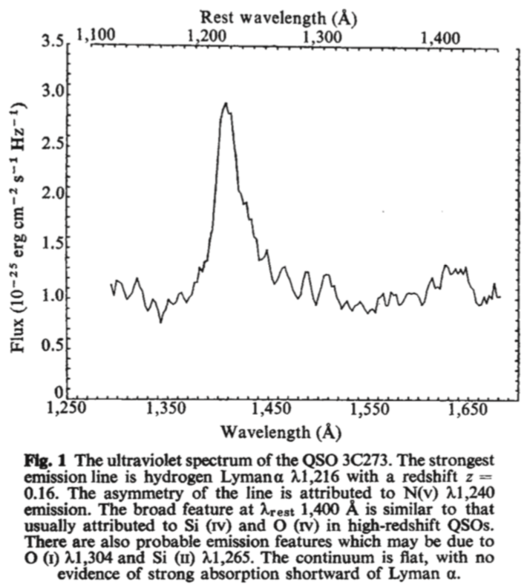
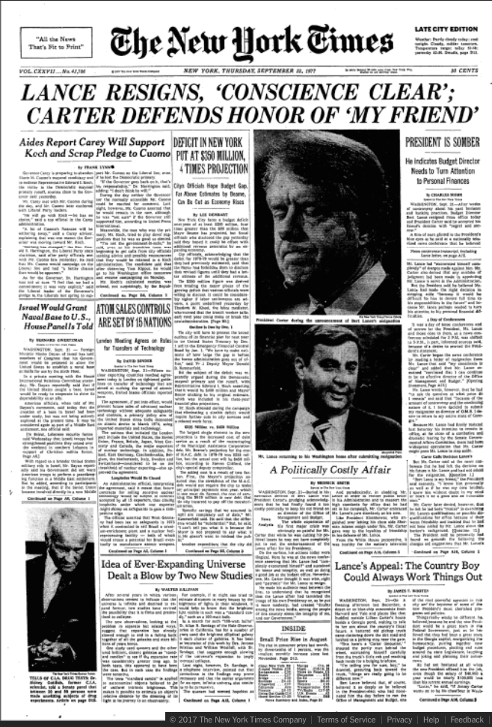
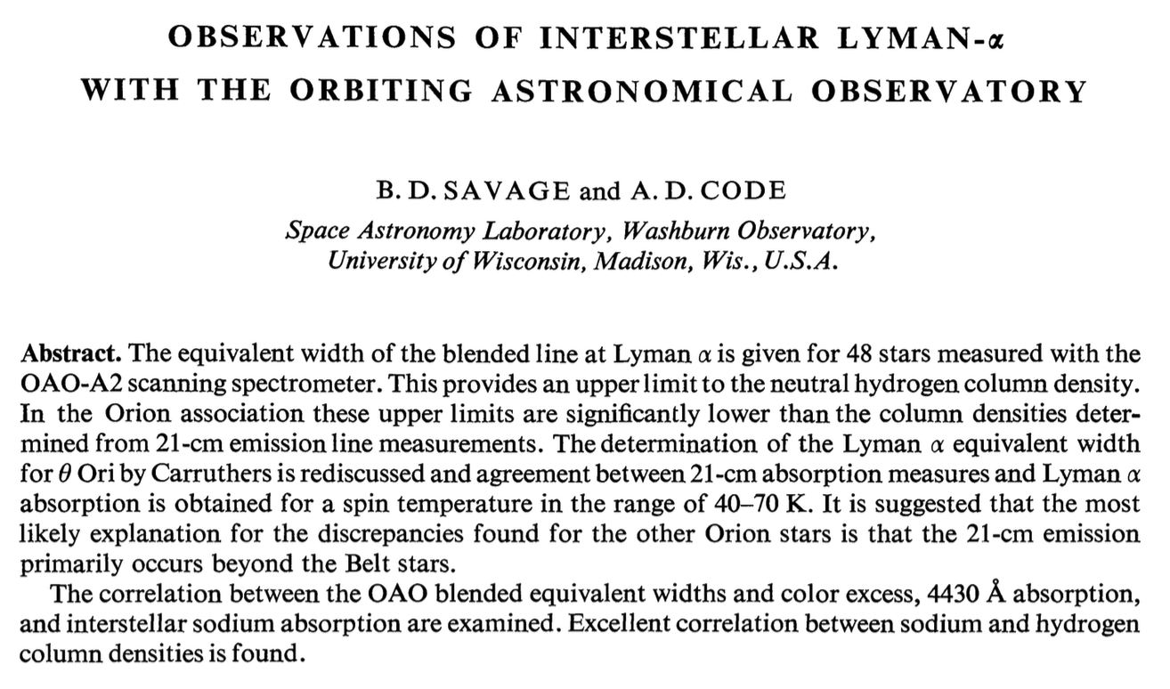
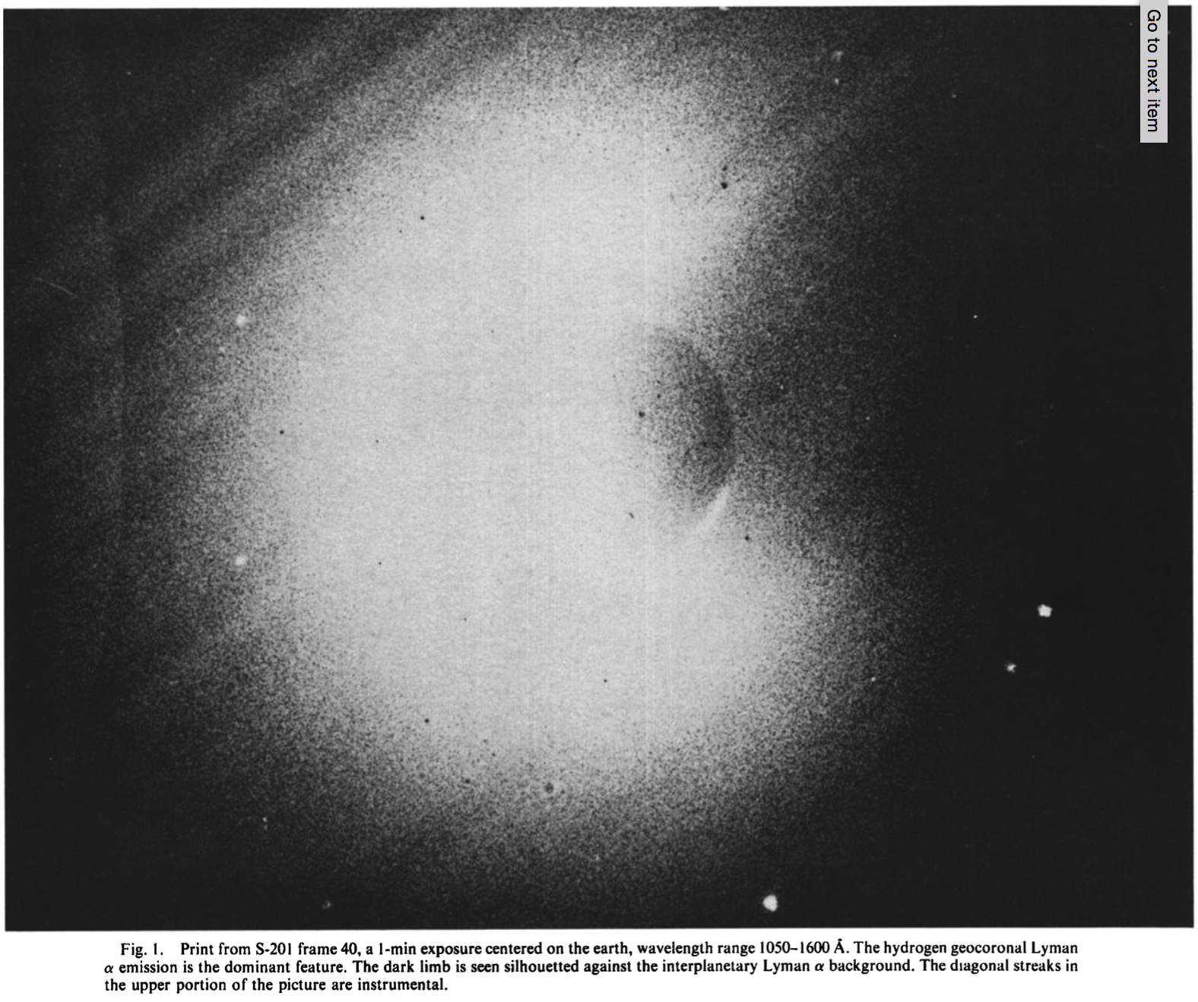
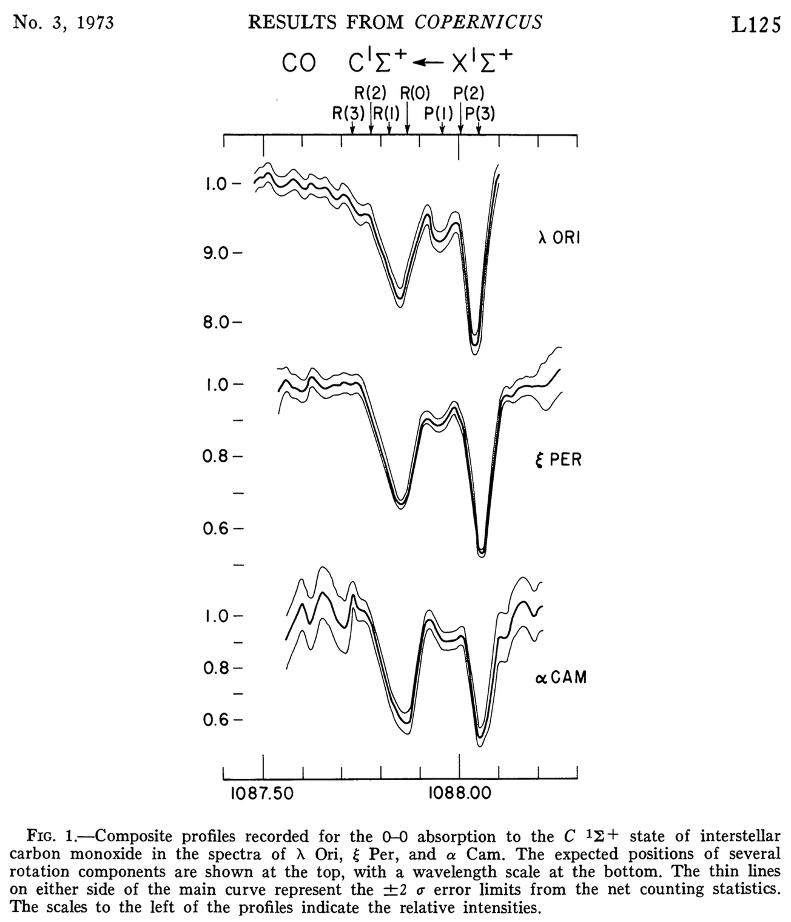
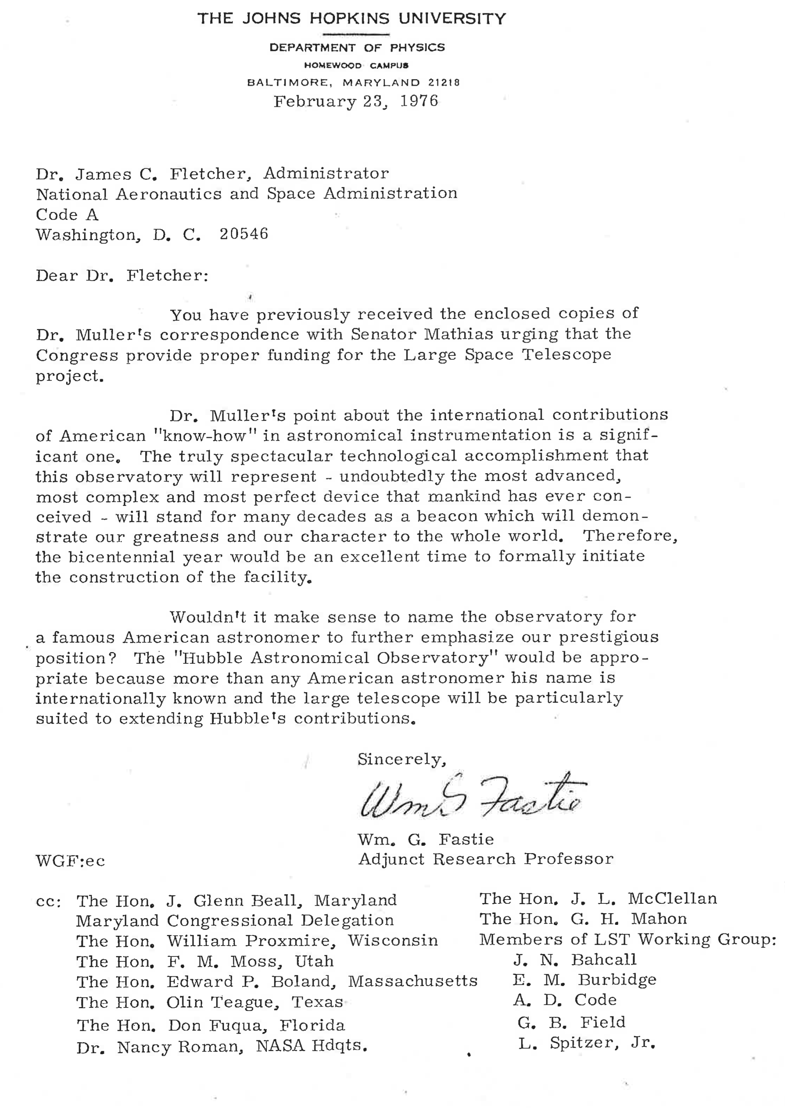
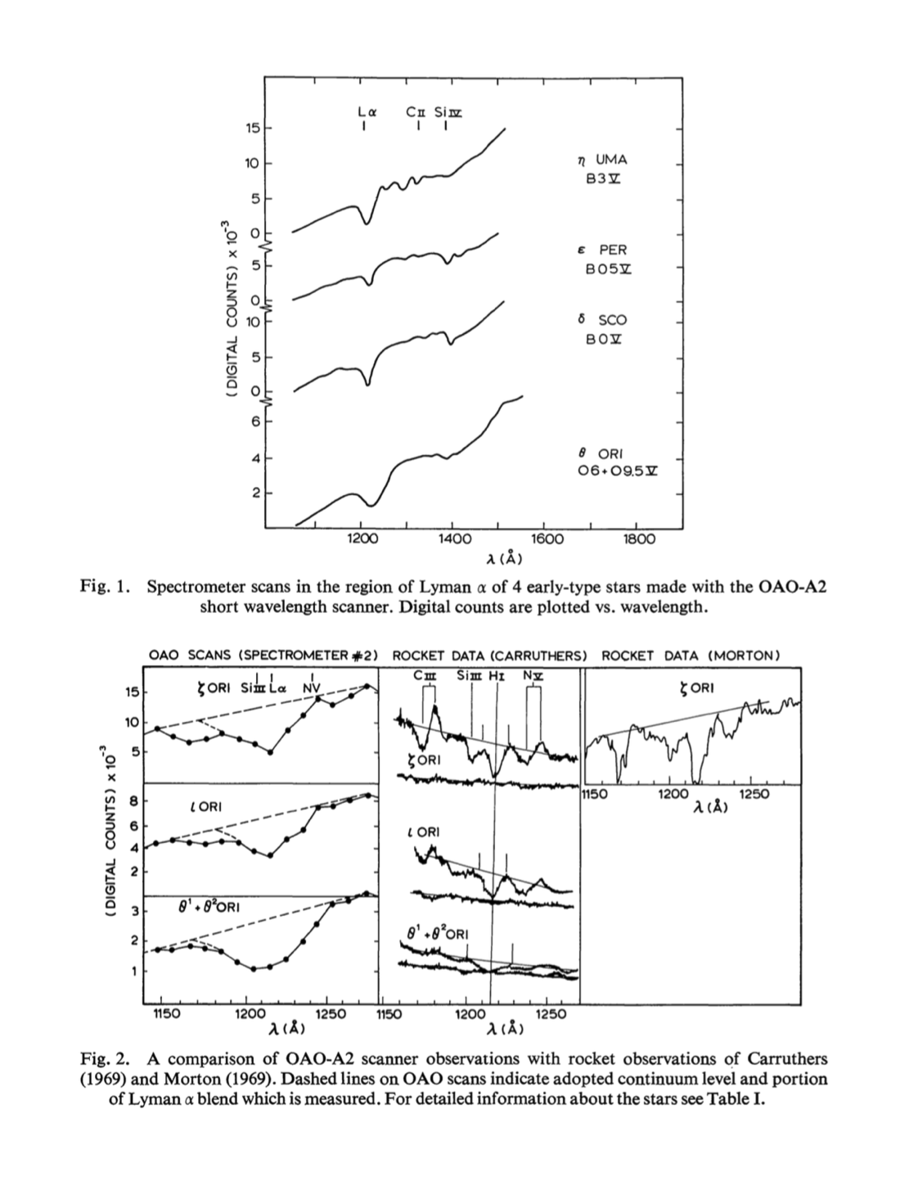
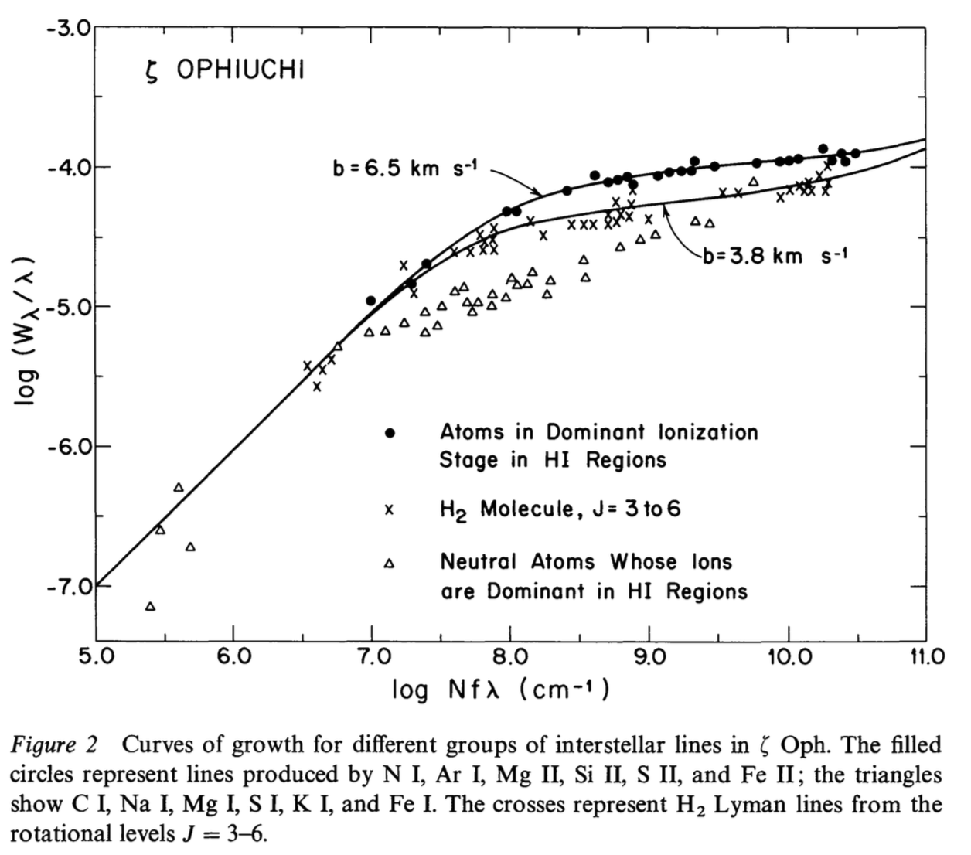
Historical Celebration – 1968 – 1977 – 60 yrs UV Astronomy
1968
1969
1970
1971
1972
1973
1974
1975
1976
1977
Stargazer
OAO-2
Code-PI Wisc Exp Package,
Wipple-PI
High Res Telescopes
Dec. 1968
H₂ from Sounding Rocket
Carruthers
1970
Apollo 16
Carruthers
Apr. 1972
Copernicus (OAO-3)
Princeton, Spitzer-PI
Aug. 1972
Apollo 17
Spectrometer
JHU, Fastie-PI
Dec. 1972
Davidsen, Hartig, Fastie
3C273, Sounding Rocket (21.054UG) Sept. 1977
  “Suddenly we were no longer astronomers, we were Astrophysicists!” – William Fastie
Fastie Names
Hubble 1976

